Slide 1

MyShot Assets for National Adult and Influenza Immunization Summit Influenza Working Group
Date

Slide 2
Template MyShot PowerPoint Slides for Inclusion in Presentations

Slide 3

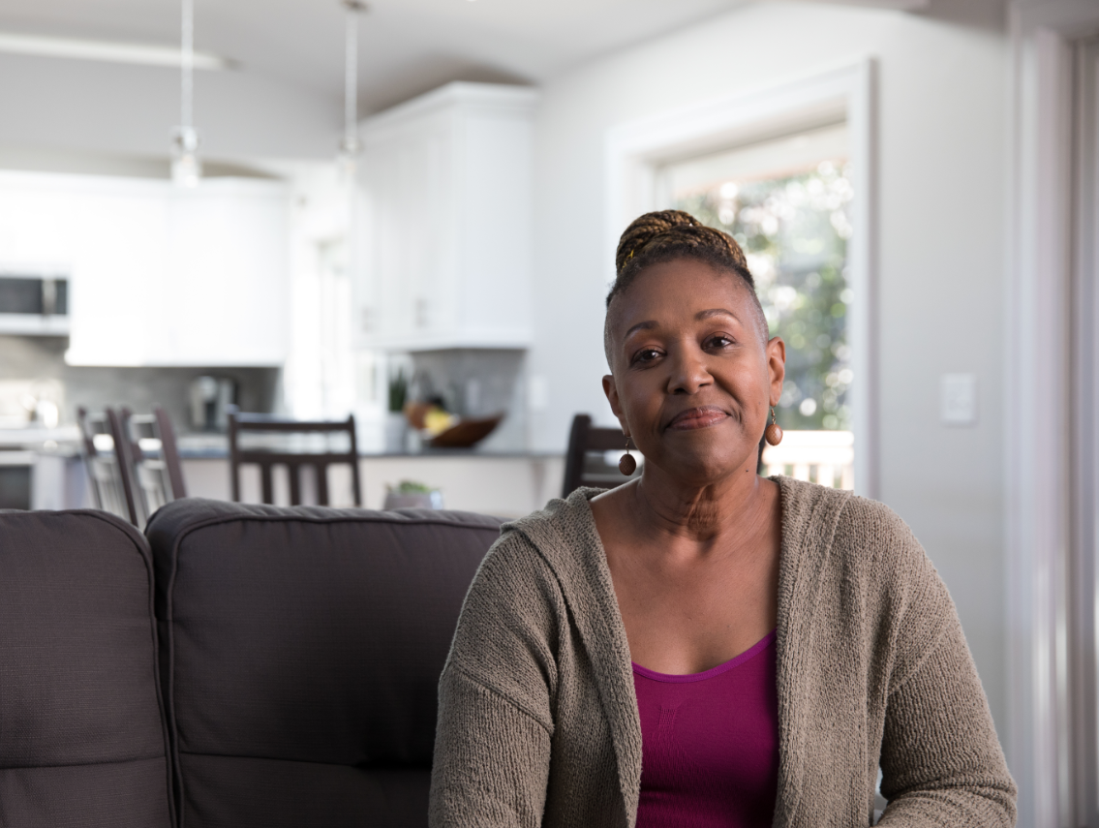
50+ Influenza Vaccination: A Missed Opportunity
There is a great need to educate people 50 years of age and older about the importance of flu vaccination:
  Seventy percent of adults 50 years of age and older have at least one chronic health condition, such as lung disease, heart disease or diabetes. When combined with the flu, these conditions can become worse and lead to serious illness.
  Vaccination rates for this group have stagnated; demonstrating a dangerous apathy toward getting vaccinated.
To help meet this need, the American Lung Association launched an awareness campaign with Sanofi Pasteur for the 2018/2019 flu season:
  Speaking directly to people 50 years of age and older to raise awareness of flu vaccination.
  Illustrating the importance of flu vaccination by sharing first-hand experiences of people with the flu.
JoJo O’Neal, an asthma patient shares her experience of getting the flu twice during last year’s flu season, and how it affected her lung disease.

Slide 4


Purpose of MyShot
Driving Flu Awareness and Action by Reinforcing…
Seriousness of flu for 50+ (e.g., increased chronic health conditions, high hospitalization and death, role of caregivers)
Importance of annual vaccination to help prevent serious disease, complications, even death
Critical need for 50+ to take flu seriously (making any medical conditions worse) and ask their doctor about flu vaccine options that might be right for them
4

Slide 5
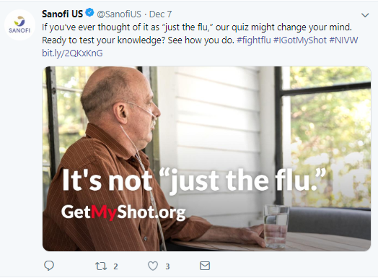
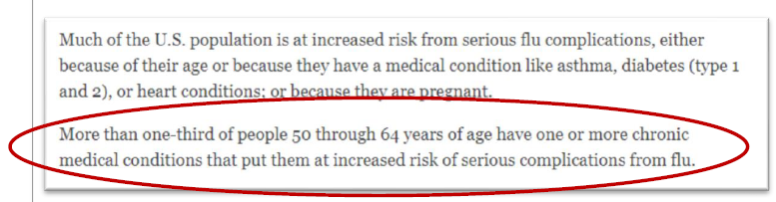

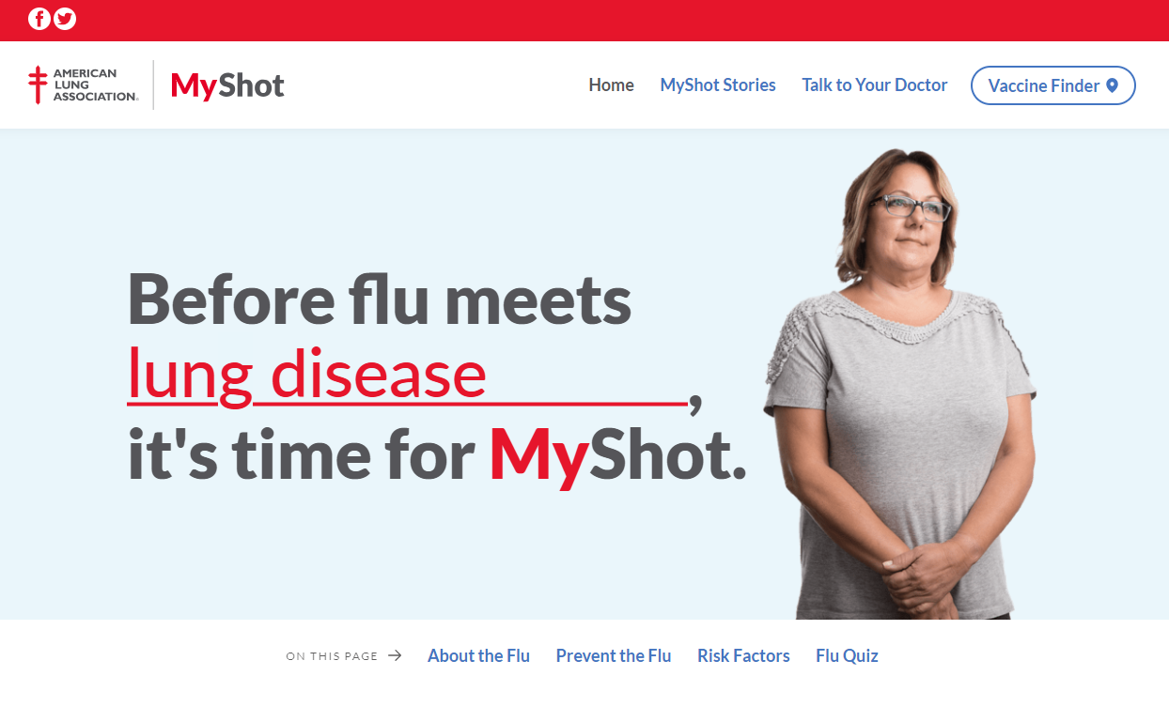
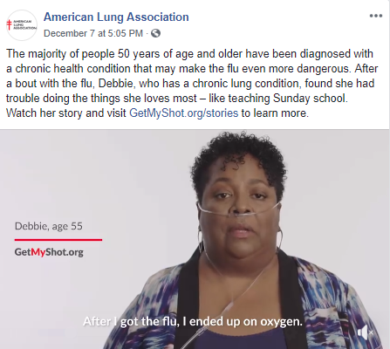
MyShot Awareness Successes
Through a variety of communication tactics, the MyShot flu campaign is making a difference, and has a campaign reach of 171 million total audience.
Flu media stories are incorporating the essential message that adults 50 years of age and older are at increased risk of complications from the flu
Stories from real patients are resonating on social media
Learn more and get involved at GetMyShot.org

Slide 6
MyShot Assets for Easy “Plug & Play” in External Communication Strategies

Slide 7
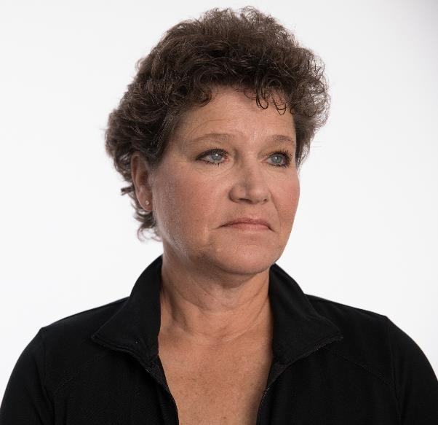
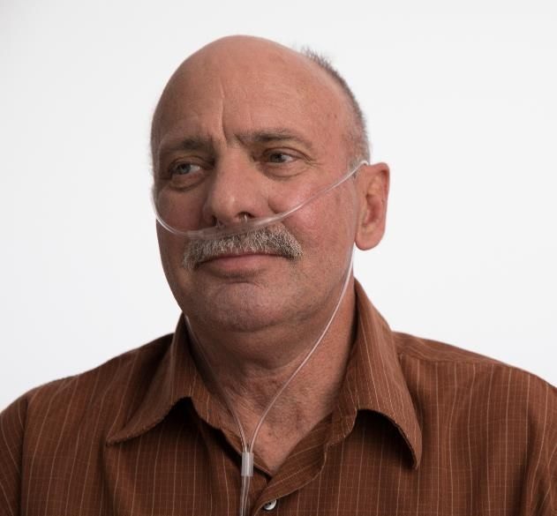




MyShot Assets
The materials on the following slides can be used for educational purposes.
MyShot images can be copied from subsequent slides or download the high-quality images by visiting this link: https://app.box.com/s/50xk1j6oxi367v0h9a9k6jvt2jt8ku0r
To access and download various MyShot videos please visit this link: https://app.box.com/s/6wpw3ukxnnfdapx5tc25uixvbogc1iu8
Resources on the microsite include:
  Flu stats and information about who is at increased risk of flu-related illness and complications
  Adults 50 years of age and older from various walks of life discussing their firsthand experiences with the flu
  Tips on how to talk to a doctor about flu risks and vaccination
  Social media resources
  Vaccine locator
For more information, please contact Erin Meyer, National Senior Director, Marketing and Communications:
  312-940-7613
  Erin.Meyer@Lung.org

Slide 8

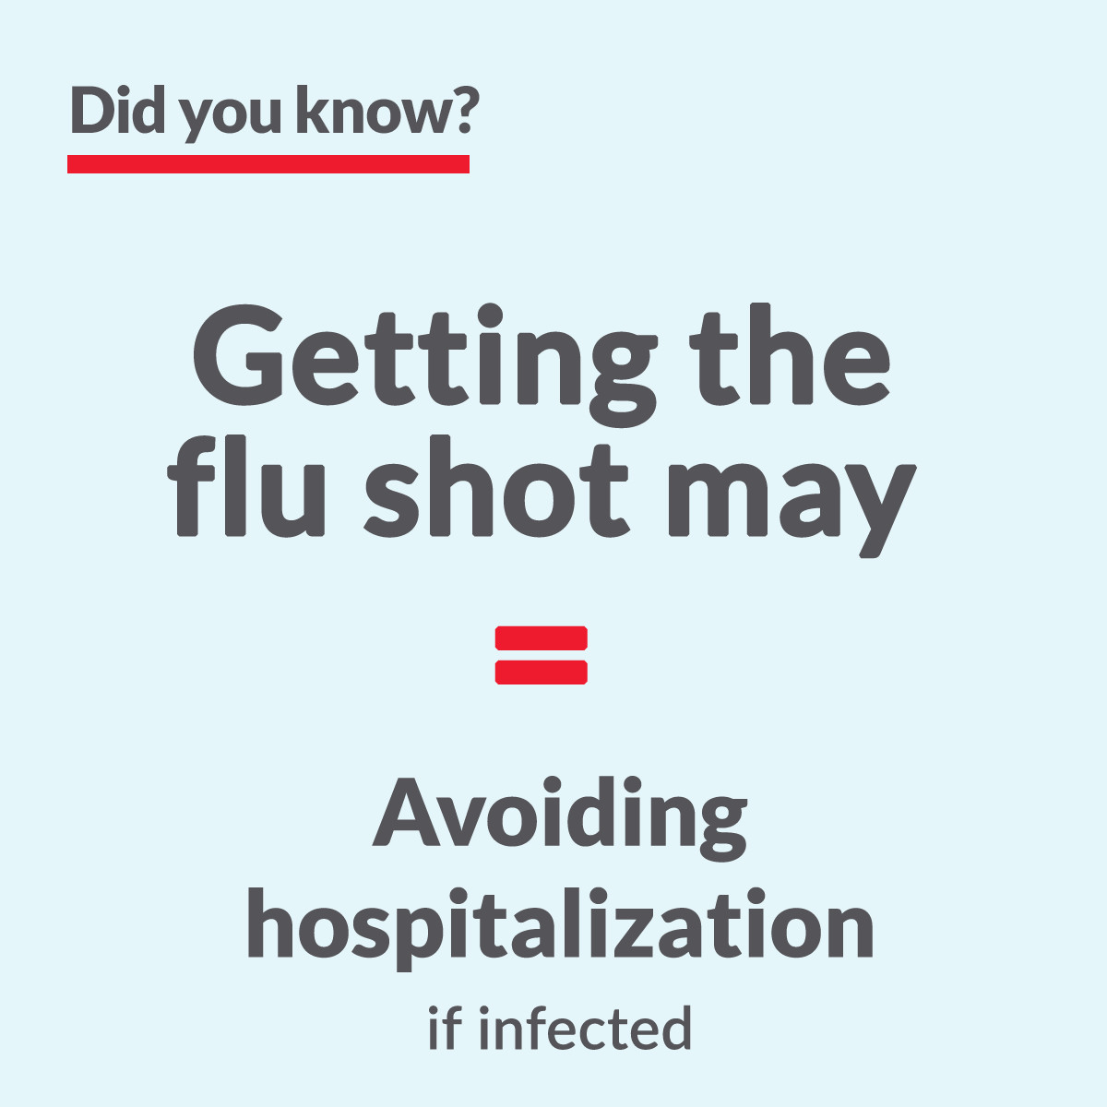
MyShot Resources
Images can be copied and pasted into any relevant materials (e.g., PowerPoint) or downloaded at this link: https://app.box.com/s/50xk1j6oxi367v0h9a9k6jvt2jt8ku0r

Slide 9
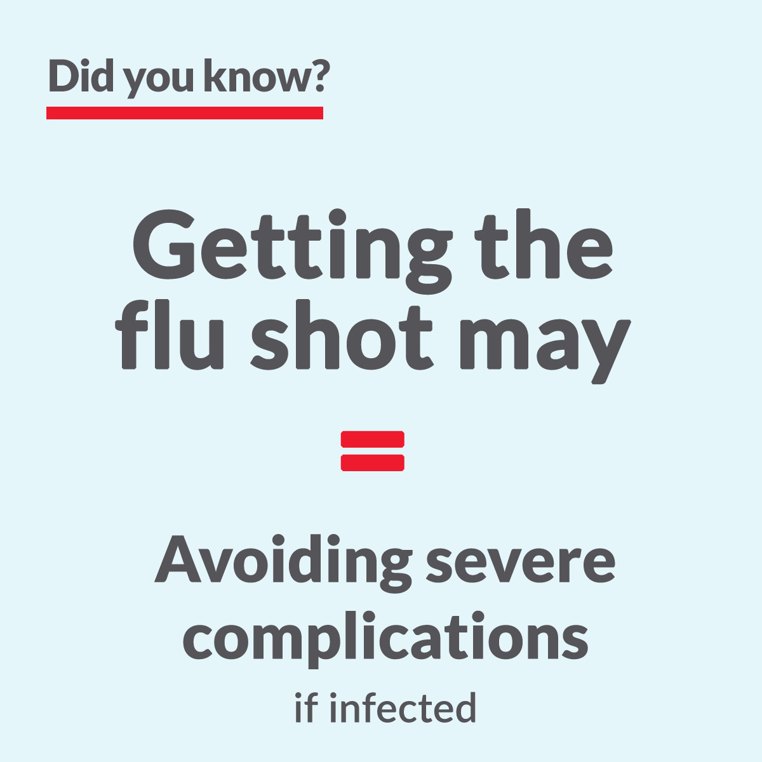
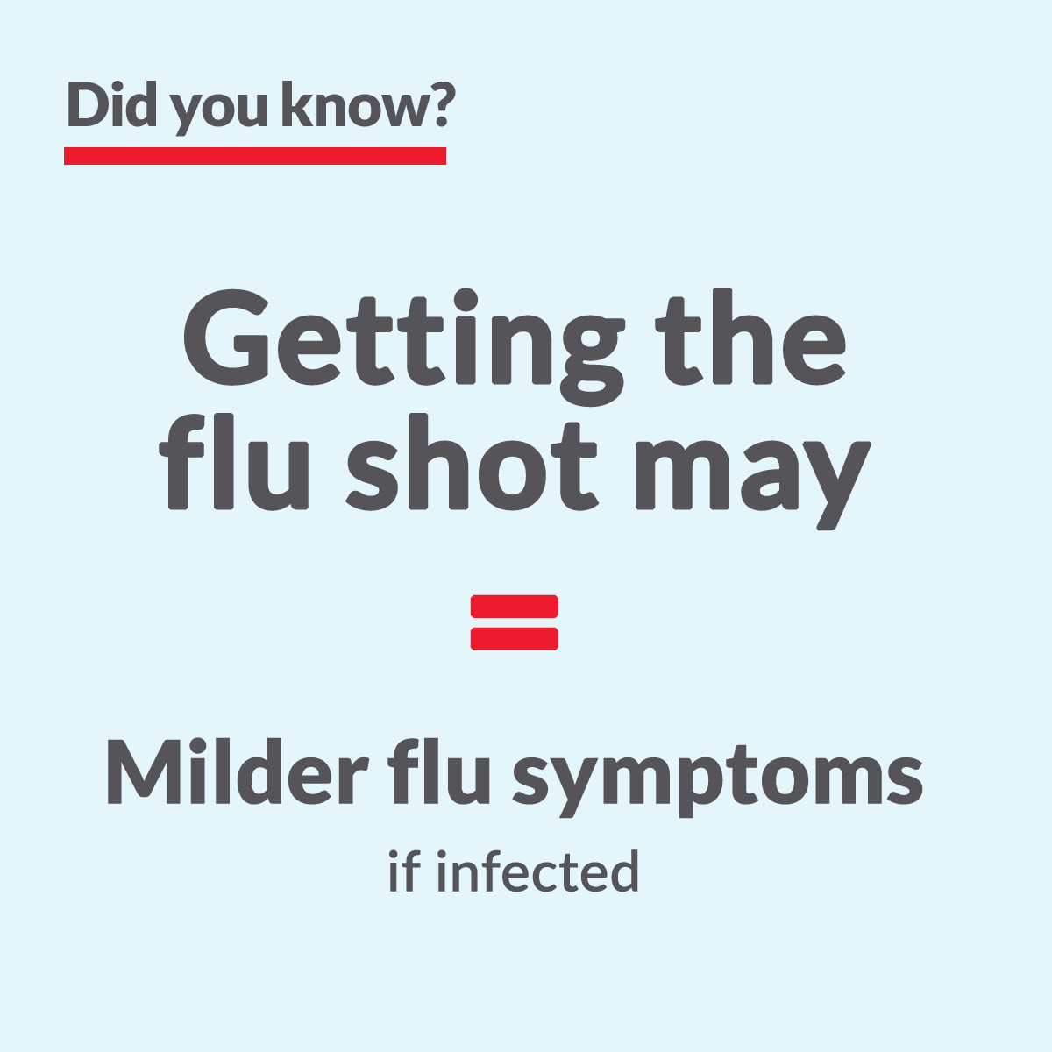
MyShot Resources
Images can be copied and pasted into any relevant materials (e.g., PowerPoint) or downloaded at this link: https://app.box.com/s/50xk1j6oxi367v0h9a9k6jvt2jt8ku0r

Slide 10


MyShot Resources
Images can be copied and pasted into any relevant materials (e.g., PowerPoint) or downloaded at this link: https://app.box.com/s/50xk1j6oxi367v0h9a9k6jvt2jt8ku0r

Slide 11

MyShot Resources
Images can be copied and pasted into any relevant materials (e.g., PowerPoint) or downloaded at this link: https://app.box.com/s/50xk1j6oxi367v0h9a9k6jvt2jt8ku0r

Slide 12

MyShot Resources
Images can be copied and pasted into any relevant materials (e.g., PowerPoint) or downloaded at this link: https://app.box.com/s/50xk1j6oxi367v0h9a9k6jvt2jt8ku0r

Slide 13

MyShot Resources
Images can be copied and pasted into any relevant materials (e.g., PowerPoint) or downloaded at this link: https://app.box.com/s/50xk1j6oxi367v0h9a9k6jvt2jt8ku0r

