Slide 1
“Best Practice” Tools for Holding Safe Vaccination Clinics in Satellite, Temporary, or Off-site Locations: Checklist and Pledge
{Insert Speaker Name}
{Insert Speaker Organization}
{Insert Event Name}
{Insert Event Date}

Slide 2
Overview
1. Background
  Unique challenges of vaccination clinics held in satellite, temporary, or off-site locations
2. Tools developed to ensure vaccination clinics held in these settings are done safely:
  The Checklist of Best Practices
  The Pledge
  Additional Resources
Notes:
As {medical and health} leaders in your industry or organization, it is likely that you have influenza vaccination clinics for your employees at the workplace. The workplace and other non-clinic settings provide excellent opportunities for adult vaccination. However, vaccination clinics in these settings have unique challenges and may also be vulnerable to unsafe environments and vaccine administration errors.
I will be describing tools, including a checklist of best practices, a pledge, and additional resources that were created to help ensure that vaccination clinics in satellite, temporary, or off-site locations, including those held at the workplace, are done safely.

Slide 3

Background
Satellite, temporary, and off-site vaccination clinics play an important role in improving vaccination coverage rates and vaccinating hard-to-reach populations
17% of U.S. adults receive their influenza vaccination at their workplace¹
http://www.cdc.gov/flu/business/index.htm?s_cid=seasonalflu-btn-055" title=
1. Black CL, Yue X, Ball SW, et al. Influenza Vaccination Coverage Among Health Care Personnel — United States, 2017–18 Influenza Season. MMWR. 2018; 67(38):1050-4. DOI: http://dx.doi.org/10.15585/mmwr.mm6738a2
Notes:
Satellite, temporary, and off-site vaccination clinics can play a very important role in improving vaccination coverage rates and vaccinating hard-to-reach populations by optimizing convenience for recipients.
Of US adults who receive influenza vaccination, 17% are vaccinated at their workplace¹.

Slide 4
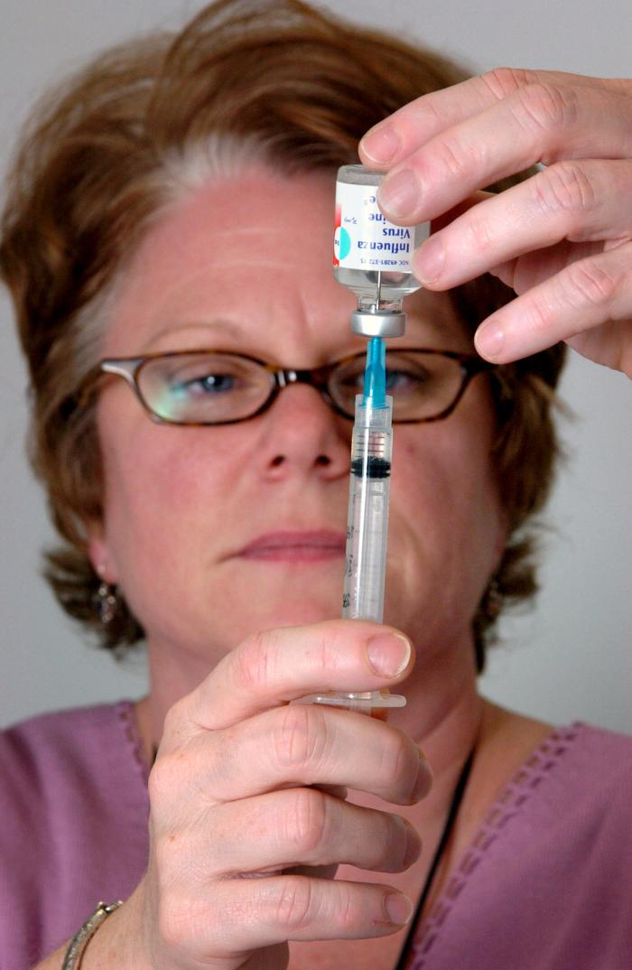
Challenges of Vaccination Clinics in Temporary Settings
Vaccination clinics held in these settings have unique challenges:
  — Training and oversight of HCP
  — Vaccine transport, storage and handling
  — Monitoring proper vaccine administration techniques
  — Managing documentation for large groups
May lead to unsafe environments, vaccine temperature excursions, and vaccine administration errors
https://phil.cdc.gov/Details.aspx?pid=5401
Notes:
However, vaccination clinics held in these non-traditional settings also have unique challenges, including:
Training and oversight of health care personnel – who are often hired and trained as “surge staffing”
Vaccine transport, storage and handling obstacles for maintaining temperature control and sterility
Monitoring proper vaccine administration techniques, and
Managing documentation for large groups without usual office-based charts
As a result of these challenges, vaccination clinics held in satellite, temporary, or off-site settings may lead to unsafe environments, vaccine temperature excursions, and vaccine administration errors.

Slide 5
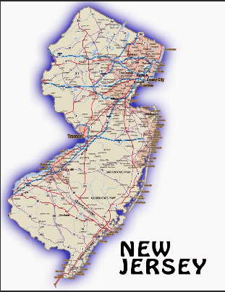
Incident— New Jersey
Sept 30, 2015:
  – NJDOH was notified of infection control breach at a workplace-sponsored flu vaccination clinic
  – A contracted nurse used same syringe on 67 patients
NJDOH found other problems with the clinic:
  Inadequate dosing
  Inappropriate transport, storage and handling
ttps://printable-maps.blogspot.com/2009/02/state-map-of-new-jersey.html
Notes:
These are not merely theoretical concerns! As some of you may remember, in the fall of 2015, adverse events at a non-hospital workplace influenza vaccination clinic illustrated almost everything that can go wrong in an influenza immunization campaign and highlighted all the vulnerabilities of nontraditional sites and surge staffing.
The following events were reported after a workplace-sponsored flu vaccination clinic in New Jersey.
On September 30, 2015, the New Jersey Department of Health (NJDOH) was notified of an infection control breach that occurred at a workplace-sponsored flu vaccination clinic held earlier that day. The nurse administering the vaccines changed the needle between each patient, but used the same syringe on 67 patients. This is a well-recognized hazard for bloodborne pathogen transmission since “flashback” of patients’ blood can occur into the barrel of a syringe.
We learned that Company A, a wellness company, had contracted with the implicated nurse to provide flu vaccines at a workplace-sponsored flu vaccination clinic for Company B.
An employee who received an injection in the flu vaccination clinic noticed that the nurse reused a syringe. After the clinic, he notified management of his employer, Company B. Company B notified Company A which then appropriately reported the breach to the NJDOH.
NJDOH found other problems with the clinic, including:
Inadequate dosing (since the nurse was drawing up the wrong amount of vaccine), and
Inappropriate transport, storage, and handling of the vaccine.

Slide 6


Coordinated Response
Coordinated response by NJDOH and CDC required
  Extensive testing for bloodborne pathogens
  Hepatitis B immunization
  Revaccination for influenza
  Follow up with NJ Board of Nursing
  Addressing mainstream media reports and concerns
Notes:
A Coordinated response by NJDOH and CDC was required, including:
Extensive testing for bloodborne pathogens
Hepatitis B immunization
Revaccination for influenza so that employees received the correct dose
Follow up with NJ Board of Nursing, and
Addressing mainstream media reports and concerns

Slide 7
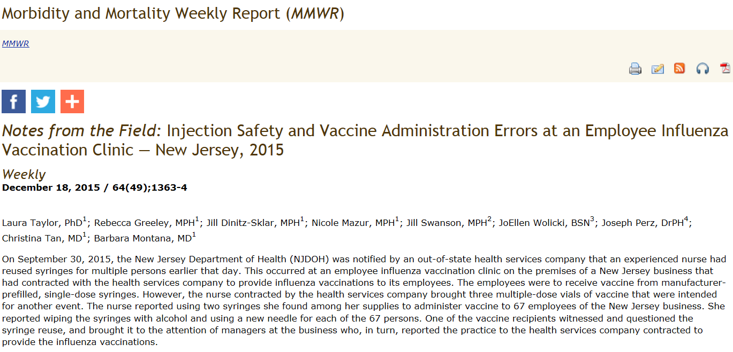
Notes:
A report of this incident was published in CDC’s Morbidity and Mortality Weekly Report in December 2015.

Slide 8
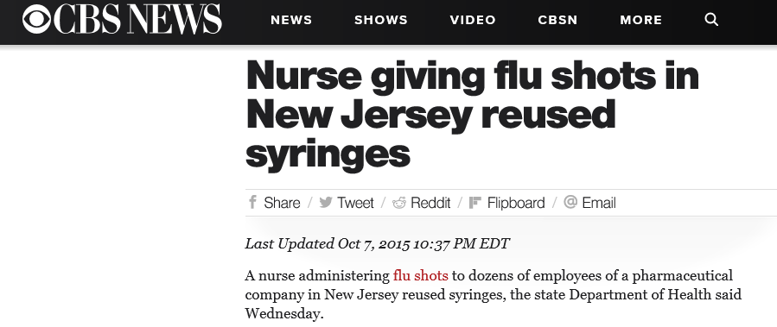
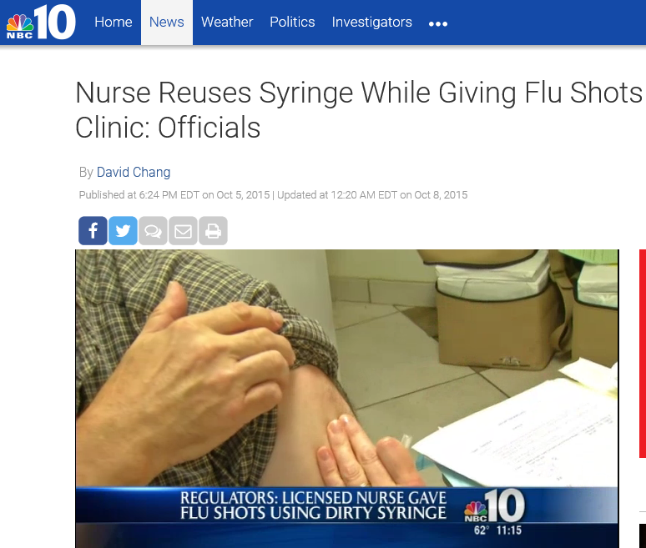
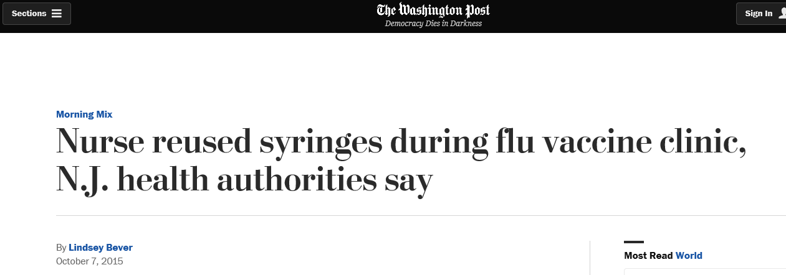
Notes:
Additionally, there was extensive media coverage in New Jersey, NY, and PA, as well as mainstream media nationally. This incident not only brought a lot of media attention, but also awareness to issues surrounding the lack of oversight at influenza vaccination clinics.

Slide 9
Other Reported Incidents
Kentucky, Ohio, and Indiana (2018): People vaccinated at workplace vaccination clinics in 3 states developed infections from vaccines being improperly stored and handled
Montgomery County, TX (2015): $70,000 worth of revaccinations required after vaccines were stored at the wrong temperature
Wellesley, MA (2010): School staff given insulin in flu vaccine error. Some staffers had to be hospitalized, but all recovered
Collier County, FL (2009): 77 students given wrong flu shot
https://www.foxnews.com/health/vaccinations-at-workplaces-in-kentucky-ohio-and-indiana-linked-to-multiple-infections-officials-say
http://www.click2houston.com/news/local/montgomery-county/re-vaccinations-required-after-error-in-montgomery-county
http://www.boston.com/news/education/k_12/articles/2010/01/19/wellesley_school_staff_given_insulin_in_flu_vaccine_error/
http://www.nbc-2.com/story/11477899/dozens-of-students-given-wrong-flu-shot
Notes:
We know of other incidents in prior years that occurred during influenza vaccination clinics both inside and outside of traditional healthcare settings, as shown here. We suspect that many safety breaches occur without identification or formal reporting.
In any case, the New Jersey incident vividly reminded us of the need to highlight CDC’s guidance on vaccine storage, handling, and administration to promote safer vaccination clinics in satellite, temporary, or off-site locations.

Slide 10
Rationale for Creating the Checklist and Pledge
No “gold standard” for organizations that run these clinics
National Adult and Influenza Immunization Summit decided to take this issue on and create a “Checklist of Best Practices” for vaccination clinics held in non-traditional settings
Notes:
At the time of this incident several years ago, there was no “gold standard” for organizations that run vaccination clinics in satellite, temporary, or off-site settings.
Thus, the National Adult and Influenza Immunization Summit’s Influenza Working Group decided to take this issue on and create a Checklist of Best Practices for vaccination clinics held in non-traditional settings.

Slide 11
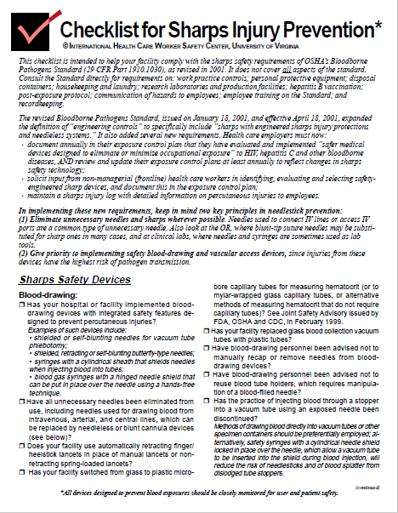
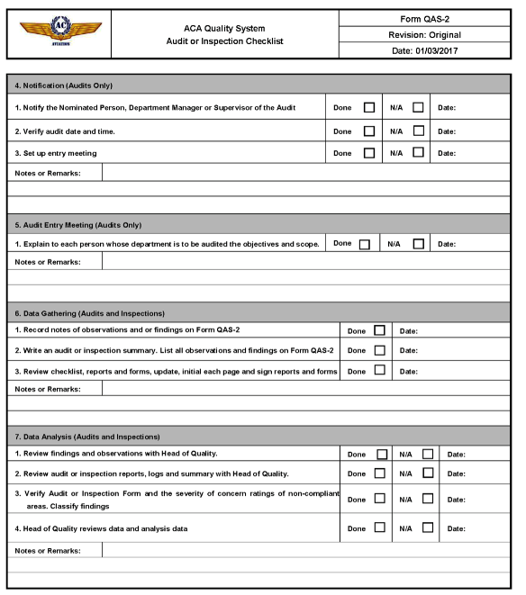
Safety Checklists are Validated Risk Reduction Tools in Healthcare and Industry
Sharps Injury Risk Reduction
Prevention of “Wrong Site” Surgeries
Aviation Safety
Mine Safety and Inspections
Laboratory Safety
Environmental Services
WHY NOT VACCINATION CLINICS?
Notes:
After all, safety checklists are validated risk reduction tools in healthcare and other industries. Thus, why not have one for vaccine clinics, particularly in temporary settings where mistakes are bound to happen?

Slide 12
National Adult and Influenza Immunization Summit
(NAIIS)
NAIIS mission: Dedicated to addressing and resolving adult and influenza immunization issues and improving the use of vaccines recommended by the Advisory Committee on Immunization Practices
NAIIS organized by: The CDC, Immunization Action Coalition, and the National Vaccine Program Office
NAIIS comprises: >700 partners, representing more than 130 public and private organizations
Notes:
To provide some background, the National Adult and Influenza Immunization Summit, or NAIIS, is dedicated to addressing and resolving adult and influenza immunization issues and improving the use of vaccines recommended by the Advisory Committee on Immunization Practices.
There are 3 organizations that lead the Summit including the CDC, the Immunization Action Coalition, and the National Vaccine Program Office.
The Summit comprises more than 700 partners, representing more than 130 public and private organizations, including professional organizations, immunization coalitions, distributors, industry, state and local health departments, and academic institutions.

Slide 13
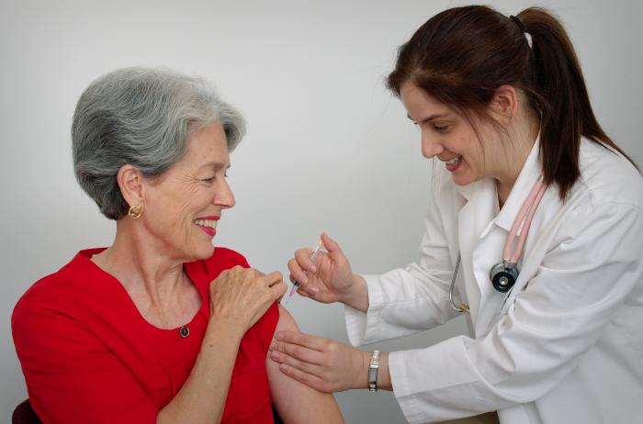
National Adult and Influenza Immunization Summit:
Influenza Working Group
Mission: Work to improve influenza vaccination coverage and promote best practices
https://phil.cdc.gov/Details.aspx?pid=9348
Notes:
There are currently 3 work groups that carry out the bulk of the work of the Summit, including our WG, the Influenza WG.
The mission of the IWG is to improve influenza vaccination coverage and promote best practices.

Slide 14
National Adult and Influenza Immunization Summit:
Influenza Working Group
To standardize the process of holding clinics in these non-traditional settings, the NAIIS Influenza Working Group developed:
  A checklist of best practices for vaccination clinics held at satellite, temporary, or off-site locations
  A pledge for organizations implementing vaccination clinics held in these non-traditional locations affirming they will adhere to best practices.
  Ten point “poster” (resource guide) summarizing the principles in the checklist
  FAQ document
Our goal was to improve safety but not to decrease access to these non-traditional vaccination clinics
Notes:
To improve, standardize and reduce risk for vaccine clinics in these non-traditional settings, the NAIIS Influenza Working Group developed:
- Checklist of best practices for vaccination clinics held at satellite, temporary, or off-site locations.
- Pledge for organizations implementing temporary vaccination clinics affirming they will adhere to best practices.
- Ten point “poster” (a resource guide) summarizing principles for safe vaccination
- FAQ webpage
Our goal was to improve safety but not to decrease access to these non-traditional vaccination clinics.

Slide 15
The Checklist of Best Practices

Slide 16
Purpose and Function of the Checklist of Best Practices
Comprehensive, step-by-step guide for clinic coordinators/ supervisors overseeing vaccination clinics
Checklist is divided into “before”, “during”, and “after” clinic sections and covers:
  Vaccine Shipment
  Vaccine Transport
  Vaccine Storage and Handling
  Clinic Preparation and Supplies
  Vaccine Administration
  Documentation
Notes:
The Checklist of Best Practices is a:
Comprehensive, step-by-step guide for clinic coordinators/supervisors overseeing vaccination clinics.
The checklist is divided into before, during, and after clinic sections and covers:
Vaccine Shipment
Vaccine Transport
Vaccine Storage and Handling
Clinic Preparation and Supplies
Vaccine Administration
And Documentation

Slide 17

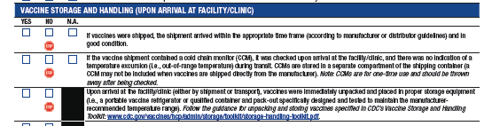
Importance of the “Stop Sign” Symbol
Critical steps for patient safety and vaccine effectiveness are identified with a stop sign icon
If any of these stop sign items are checked as “NO,” users are directed to STOP the clinic and follow their organization’s protocols and/or contact the state or local health department before proceeding
Notes:
Throughout the checklist, critical steps for patient safety and vaccine effectiveness are identified with a stop sign icon.
If any of these stop sign items are checked as “NO,” users are directed to STOP the clinic and follow their organization’s protocols and/or contact the state or local health department before proceeding

Slide 18
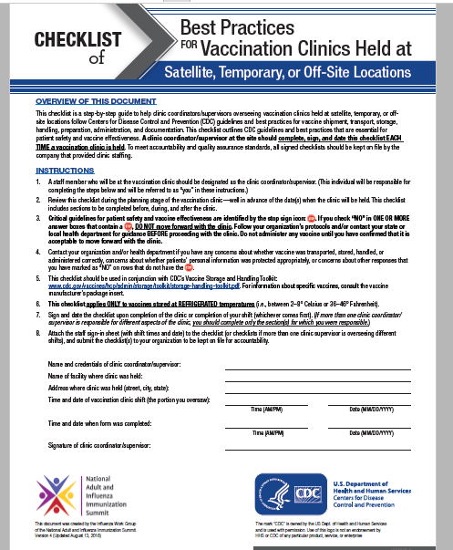
Title Page of Checklist
Notes:
Now I will take you through each section of the checklist.
The title page provides an overview of the checklist on the top,
Gives step by step instructions on how to use the checklist in the middle,
And provides space for signatures of the clinic coordinator/supervisor and dates of the clinic at the bottom.

Slide 19
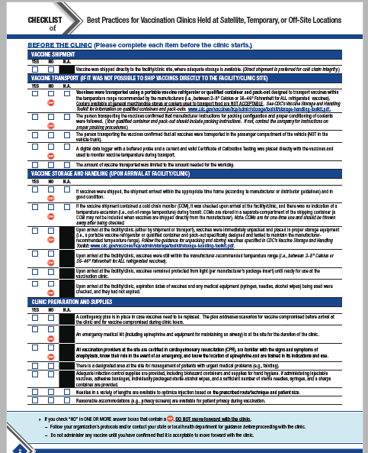
“BEFORE the Clinic” Section of the Checklist
Notes:
In the main body of the checklist, there are 4 full pages of rows to check. This slide shows the first full page of the checklist. There are 3 main sections: “before the clinic”, “during the clinic”, and “after the clinic”. Within each section, there are subsections identified by the blue rows. In the next few slides, I will walk you through each of the sections and subsections.

Slide 20
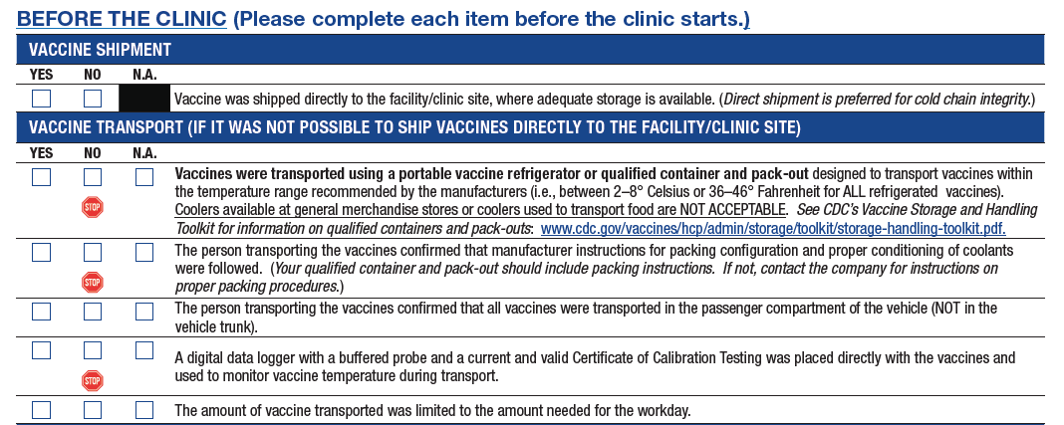
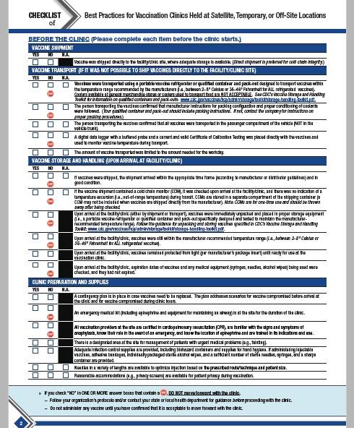
“BEFORE the Clinic” Section of the Checklist
Notes:
The first subsection in the “before the clinic” section covers vaccine shipment which is highlighted in the top light blue row, and shown in the red inset. We strongly recommend that vaccine is shipped directly to the facility or clinic site.
However, since many organizations opt not to ship directly to the site or are unable to receive shipments directly to the site, we included a subsection on vaccine transport which is highlighted in the second blue row. This subsection of rows includes 3 stop signs, because if the vaccine is not transported using a portable vaccine refrigerator or qualified container and packout designed to transport vaccines within the temperature range recommended by the manufacturers, then the clinic should not proceed.

Slide 21
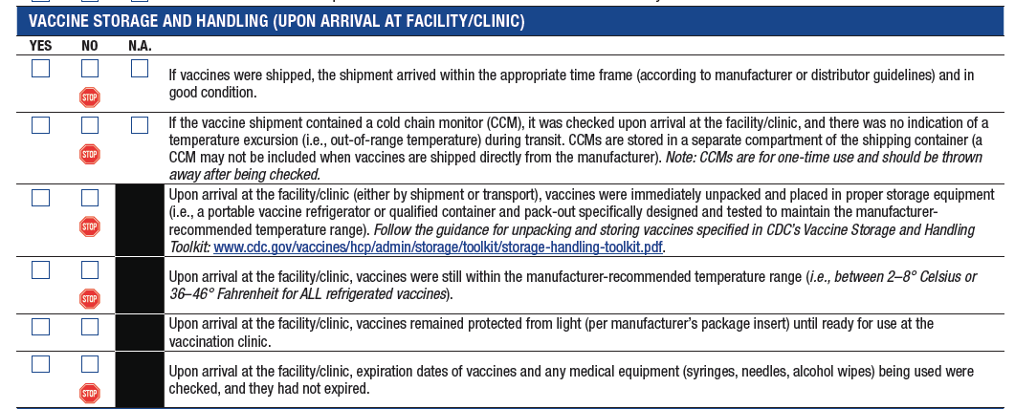
“BEFORE the Clinic” Section of the Checklist
Notes:
The next subsection of the checklist that should be completed is the Vaccine Storage and Handling that occurs upon arrival at the facility or clinic. Again, you’ll notice that there are stop signs in almost every single row in this subsection since maintaining the proper temperature of the vaccine is of utmost importance.

Slide 22
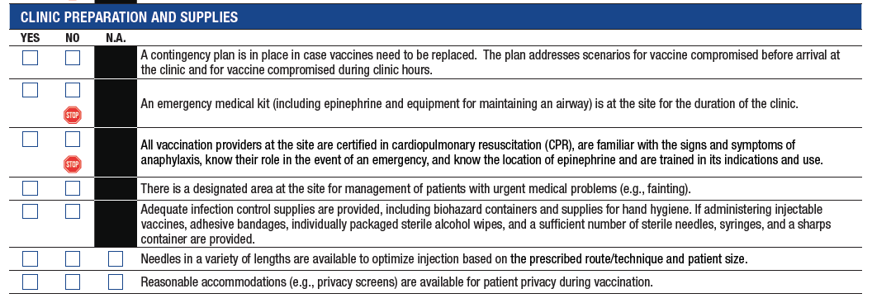
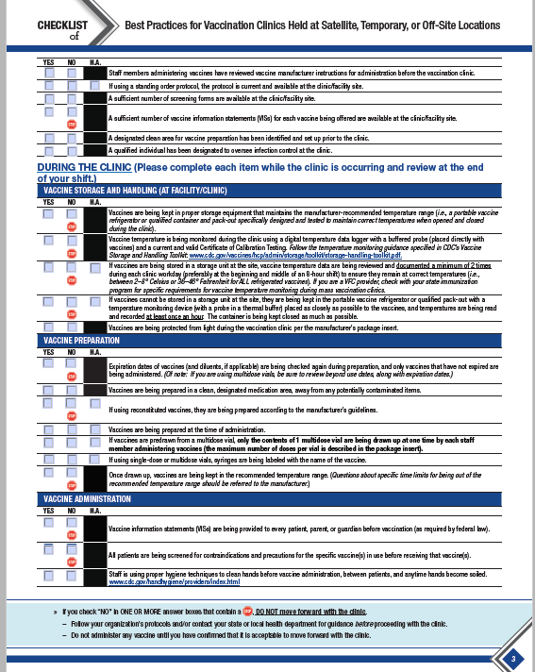
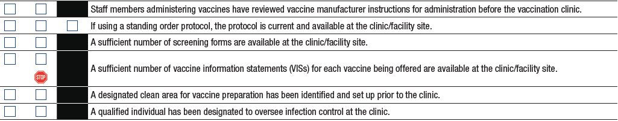
“BEFORE the Clinic” Section of the Checklist
Notes:
The final topic in the “Before the Clinic” section of the checklist is about clinic preparation and supplies.
The stop sign items in this section include having an emergency medical kit and having providers on site who are certified in CPR and dealing with medical emergencies.

Slide 23
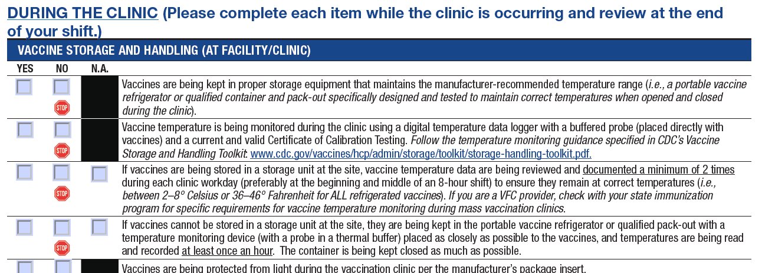
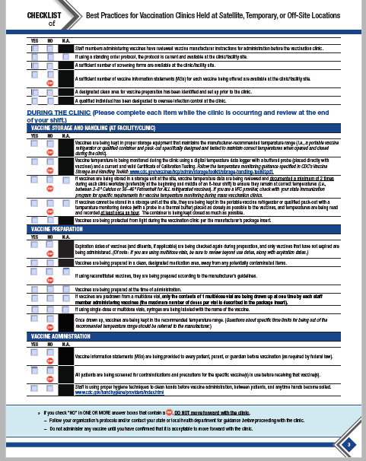
“DURING the Clinic” Section of the Checklist
Notes:
The second section of the checklist is the “During the Clinic” section. This section is to be completed while the clinic is occurring and reviewed at the end of the shift.
The first subsection in the “During the Clinic” section covers vaccine storage and handling at the facility or clinic.

Slide 24
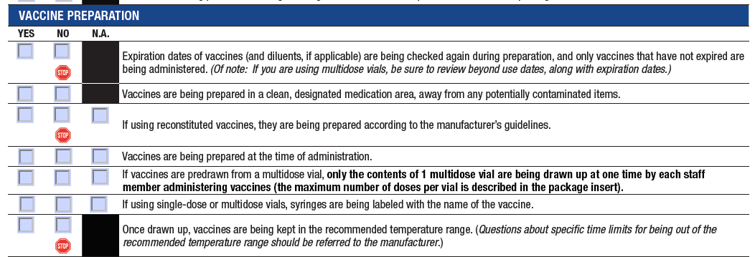
“DURING the Clinic” Section of the Checklist
Notes:
The second subsection for during the clinic is on vaccine preparation. Stop signs are included to verify that expiration dates of vaccines are being checked and are not expired and again to check that vaccines are being kept in the recommended temperature range once they’ve been drawn up.

Slide 25
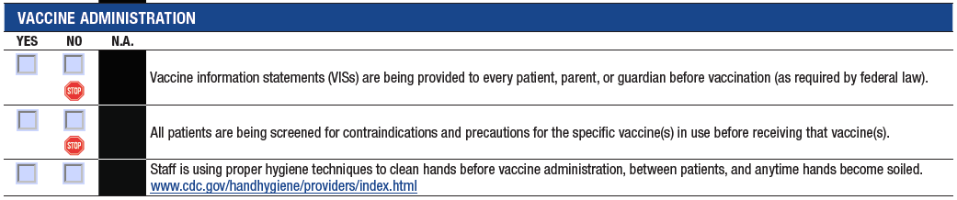
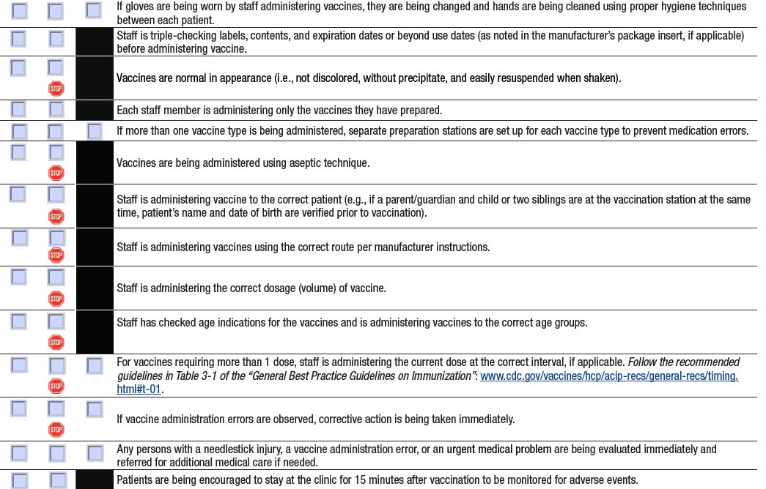
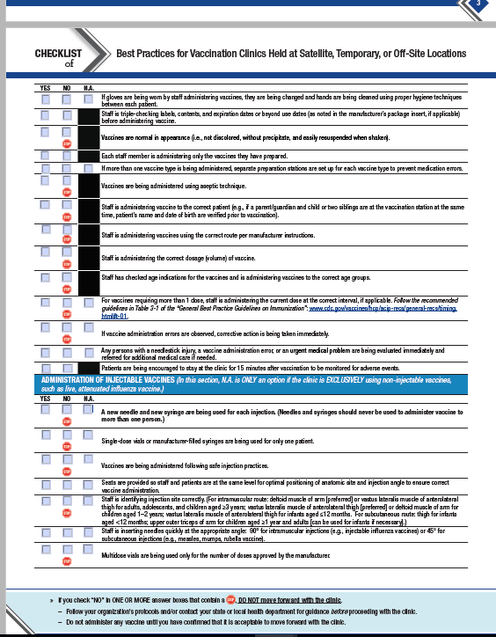
“DURING the Clinic” Section of the Checklist
Notes:
The third subsection to be completed “During the Clinic” is for Vaccine Administration. There are a number of stop signs in this subsection for the clinic coordinator to make sure that staff is administering vaccines using the correct route and dose to the correct patient.

Slide 26
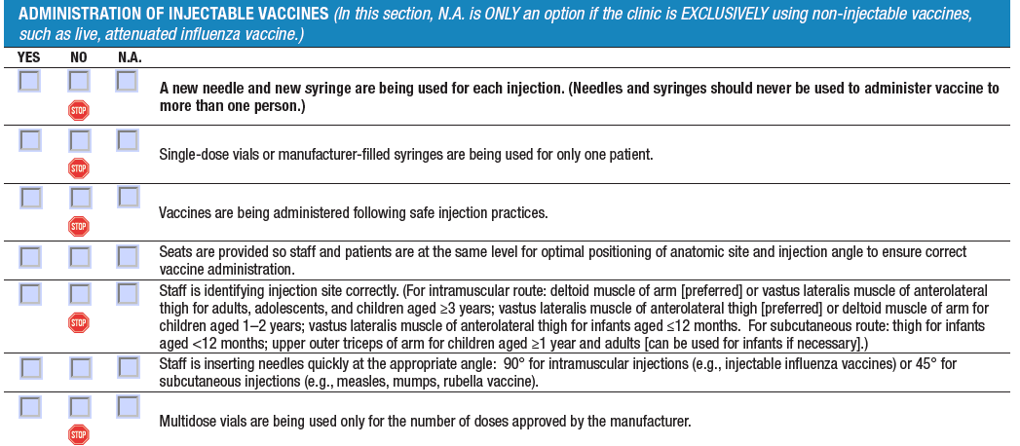
“DURING the Clinic” Section of the Checklist
Notes:
There is also a subsection on administration of injectable vaccines.

Slide 27
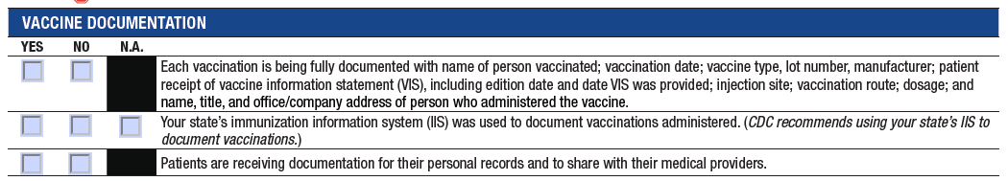
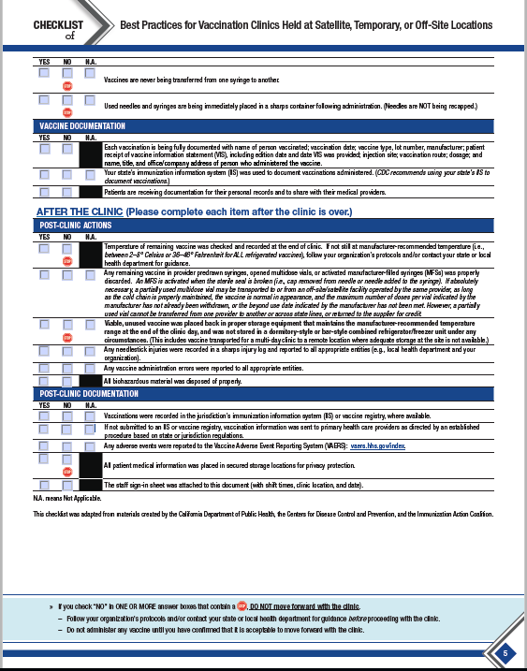
“DURING the Clinic” Section of the Checklist
Notes:
Vaccine documentation is the last section to be completed during the clinic.

Slide 28
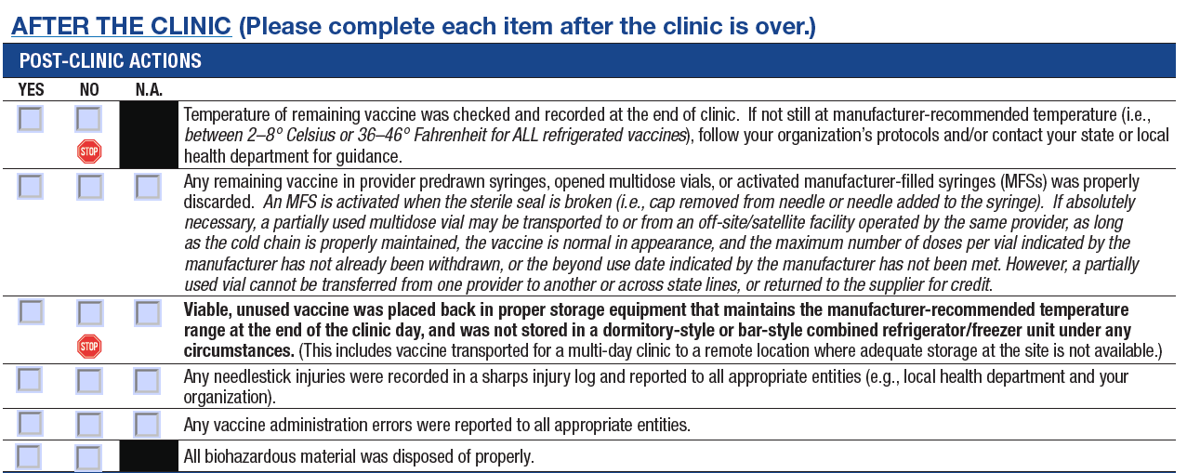
“AFTER the Clinic” Section
Notes:
The Final Section of the checklist pertains to “after the clinic”.

Slide 29
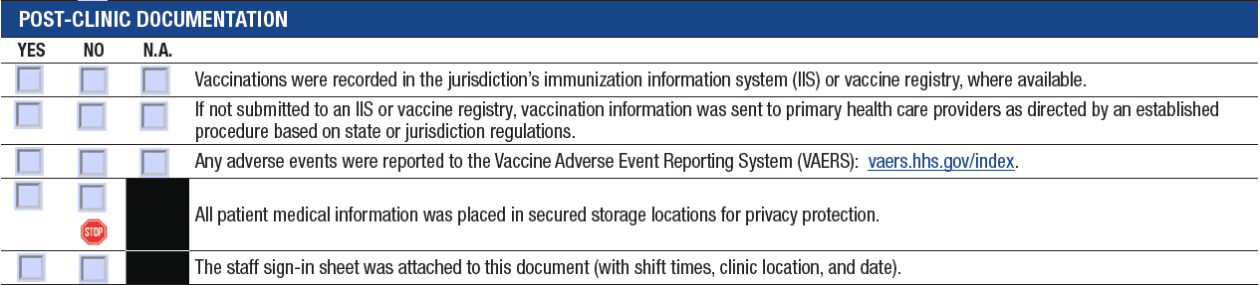
“AFTER the Clinic” Section
Notes:
The final subsection relates to post-clinic documentation with a stop sign on placing patient medical information in secured storage locations.

Slide 30
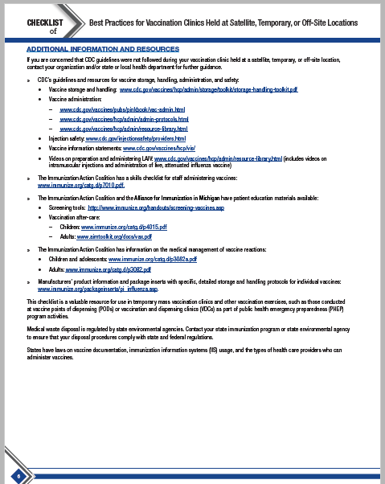
Checklist Resources
Notes:
On the final page of the checklist, we’ve included additional information and resources.

Slide 31
Putting the Checklist to Use
If your vaccination clinics are done in-house by your Occupational Health staff, it’s important to make sure they are using the checklist
If you hire out your vaccination clinics to an agency, prior to signing a contract with them, you can ask that they follow the checklist and sign the pledge
Notes:
This is a useful resource, but only if it is actually being used.
If your vaccination clinics are done in-house by your Occupational Health staff, it’s important to make sure they are using the checklist
If you hire out your vaccination clinics to an agency, prior to signing a contract with them, you can ask that they follow the checklist and sign the pledge.

Slide 32
The Pledge

Slide 33
The Pledge
Organizations pledge to adhere to CDC guidelines and best practices when implementing vaccination clinics
  — Including adhering to the Checklist
Reviewed and signed annually by an organization executive
Completed pledges should be sent to NAIIS Clinic Pledge Coordinator:
  — vaxclinicpledge@izsummitpartners.org
Notes:
The pledge can be signed by organizations that adhere to CDC guidelines and best practices when implementing vaccination clinics, this includes adhering to the checklist at every vaccination clinic.
The pledge should be reviewed and signed annually by an organization executive.
Completed pledges should be sent to the Summit Clinic Pledge Coordinator
vaxclinicpledge@izsummitpartners.org

Slide 34
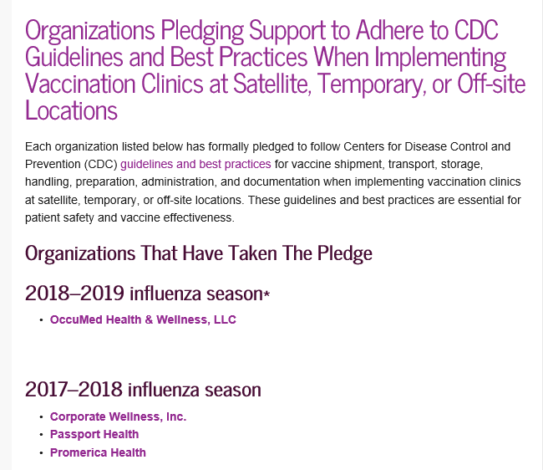
Benefits of Signing the Pledge
Notes:
There are many benefits to organizations that sign the pledge. Pledging organizations are recognized on the Summit’s “Organizations Pledging Support Page”, as shown here. This is also an honor that can be included in your organization’s promotional materials, and as a way to show that an organization follows the gold standard, as far as safety guidelines.

Slide 35
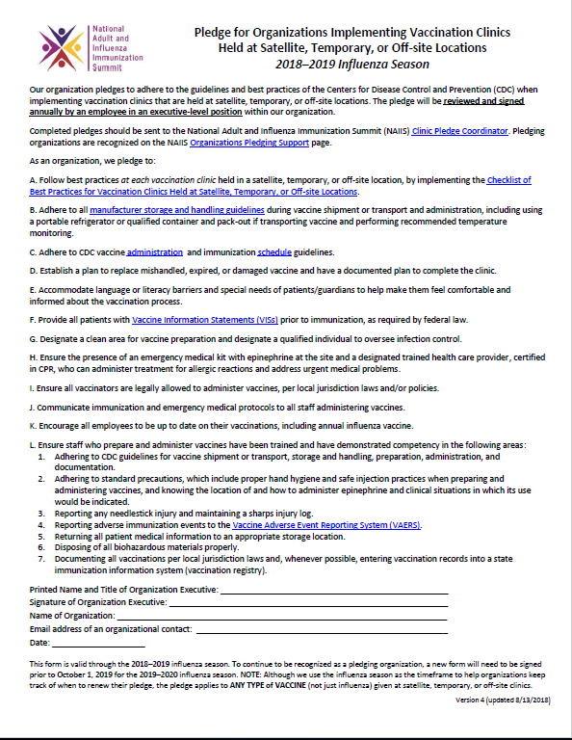
The Full Pledge
Notes:
This slide shows the full pledge, and on the next few slides, I will highlight each component of the pledge.

Slide 36
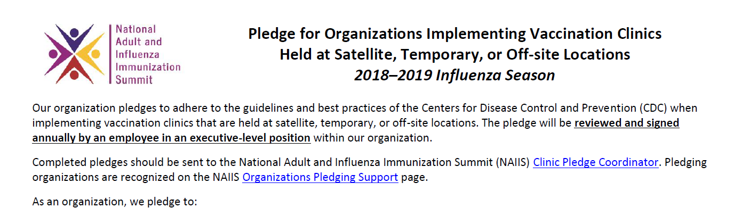
Pledge Components
Notes:
The first section of the pledge which is highlighted in the red text box in the inset gives directions on the purpose of the pledge, who should sign it, and where to send the completed pledge form.

Slide 37
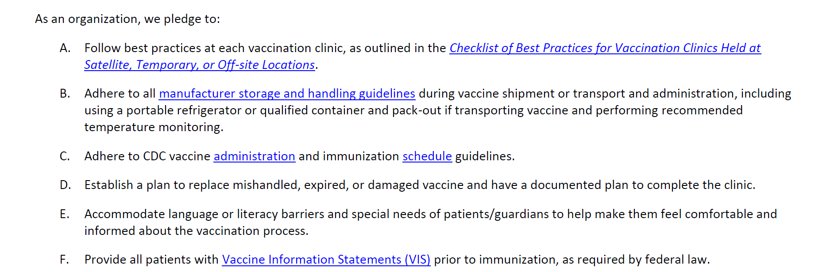
Pledge Components (Cont)
Notes:
The next section of the pledge (highlighted in red in the inset) covers topics including:
-following best practices at each vaccination clinic by using the checklist.
-Adhering to all manufacturer storage and handling guidelines, and
-Having a plan to replace expired or damaged vaccine.

Slide 38
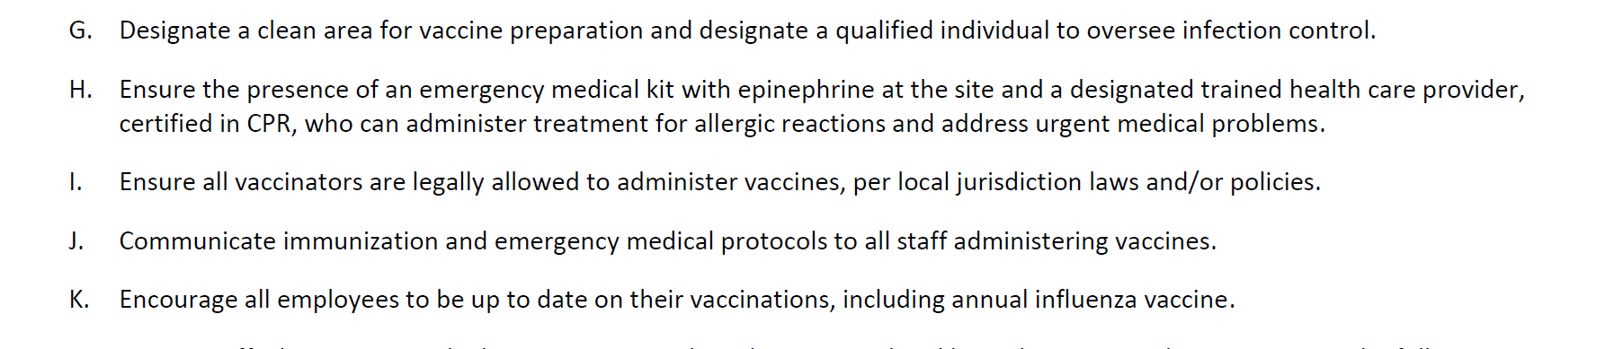
Pledge Components (Cont)
Notes:
Here are an additional 5 requirements as noted in rows G- K, including ensuring that all vaccinators are legally allowed to administer vaccines.

Slide 39
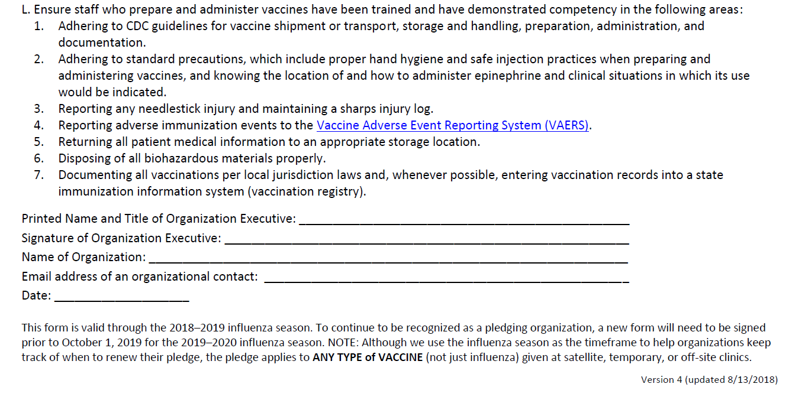
Pledge Components (Cont)
Notes:
On the bottom of the pledge, it states that all staff who administer vaccines should be trained and have demonstrated competency.
Then there is a place for the organization executive to sign and date.

Slide 40
Additional Tools
Notes:
I also wanted to discuss a couple additional tools that we’ve created.

Slide 41
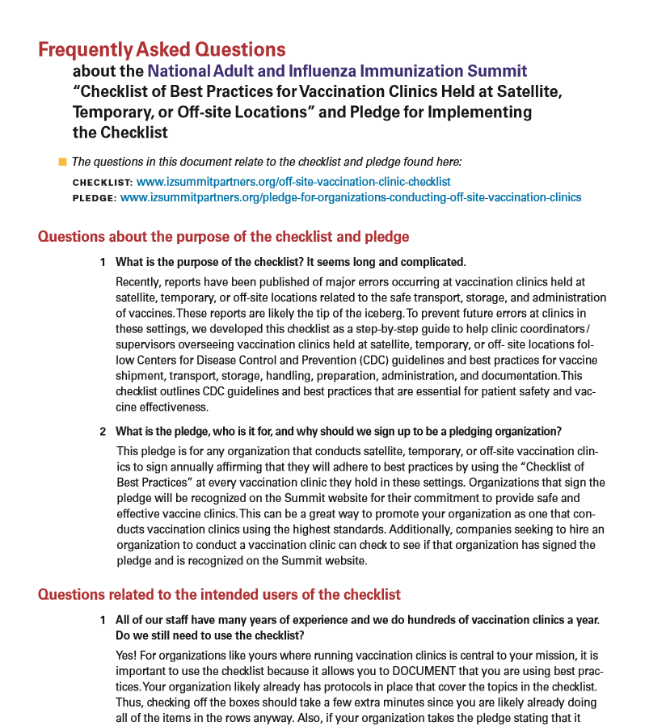
“Frequently Asked Questions” Document
Notes:
In response to numerous questions we’ve received since publishing the checklist and pledge, we’ve developed a “Frequently Asked Questions” page, shown here.

Slide 42
“Frequently Asked Questions” Document
Examples of Questions on the FAQ :
All of our staff have many years of experience and we do hundreds of vaccination clinics a year. Do we still need to use the checklist?
We have many new staff all over the country. The checklist seems too cumbersome to use in our situation. Do we need to use it?
Are we allowed to use coolers purchased at big box stores/retail stores for transporting vaccine?
Notes:
Questions on the FAQ include:
All of our staff have many years of experience and we do hundreds of vaccination clinics a year. Do we still need to use the checklist? The answer is yes, and more detail is provided on the FAQ document.
We have many new staff all over the country. The checklist seems too cumbersome to use in our situation. Do we need to use it? Again, the answer is yes, with a detailed response on the document.
Are we allowed to use coolers purchased at big box stores/retail stores for transporting vaccine? The answer here is no, with the rationale that this is not an acceptable practice and that vaccine should be transported in qualified containers and pack-outs.

Slide 43
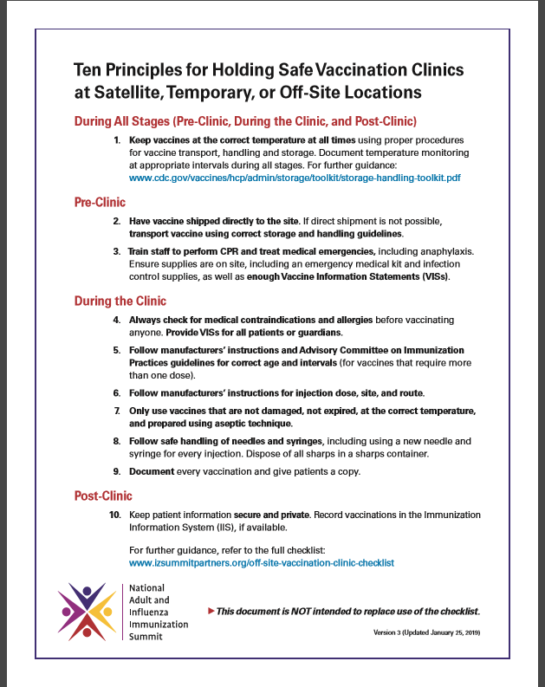
1- Page Summary Resource
Notes:
Also, in response to feedback we received, we created a 1 –page summary resource titled “Ten Principles for Holding Safe Vaccination Clinics at Satellite, Temporary, or Off-site Locations”, as shown here. This resource is not intended to replace the checklist. Rather, it is a summary document of the main points on the checklist in 10 concise bullet points.

Slide 44
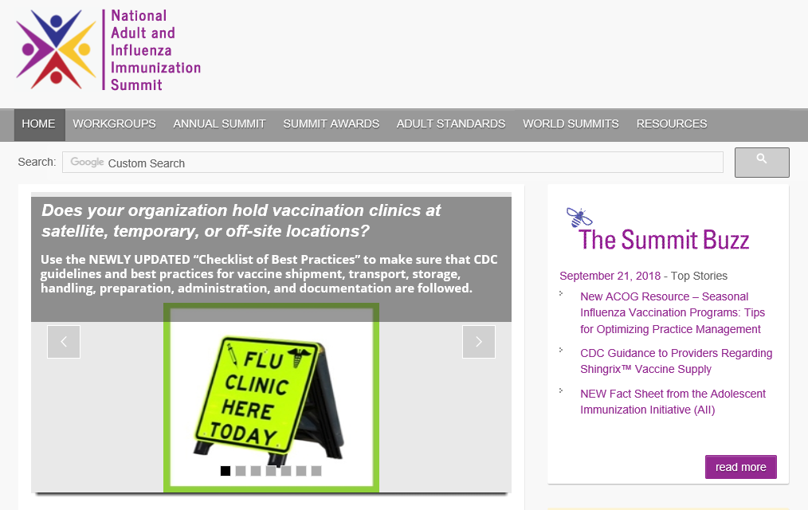
Where to Find These Documents: From NAIIS Home Page
Notes:
Next, I would like to make sure you know where you can find these resources. The checklist can be found by going to the homepage for the National Adult and Influenza Immunization Summit. The picture outlined in red here, rotates images, but when this Flu Clinic Sign is on the screen and you click on it, it will take you directly to the checklist.

Slide 45
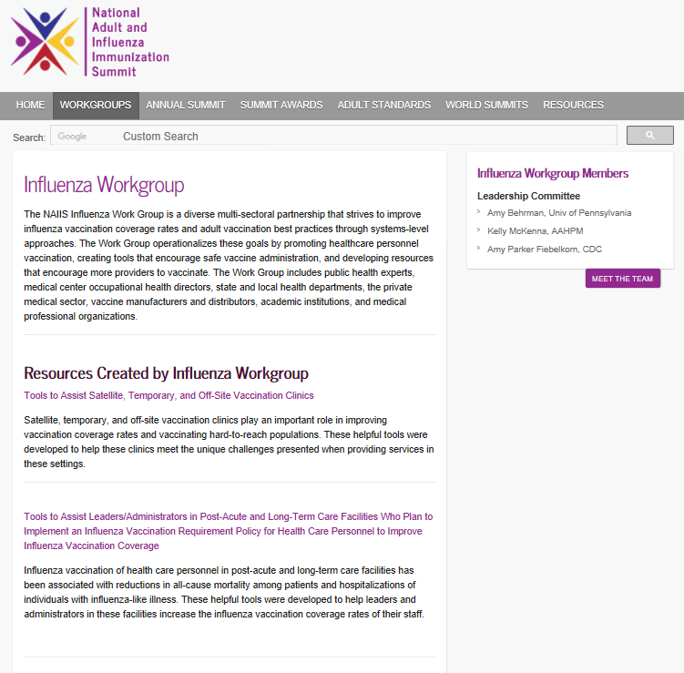
Where to Find These Documents:
Under the “WORKGROUP” Tab
Notes:
However, if you would rather go to the landing page for all 4 resources, then you can go to the gray bar, and then under the “WORKGROUP” tab, highlighted in red, select “Influenza Workgroup”. This will take you to the Influenza Workgroup’s page, as shown here. Next, click on “Tools to Assist Satellite, Temporary, or Off-Site Vaccination Clinics”.

Slide 46
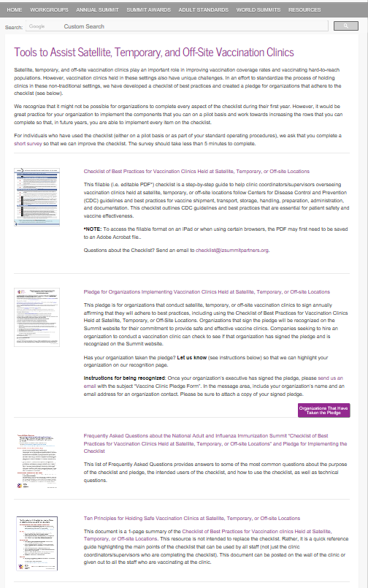
Landing Page for These Tools
Notes:
This will take you to the landing page that has direct links to each of the documents we’ve discussed, shown here.

Slide 47
Where to Find These Documents
Landing page for all 4 documents: https://www.izsummitpartners.org/naiis-workgroups/influenza-workgroup/off-site-clinic-resources/
  Checklist:
    www.izsummitpartners.org/off-site-vaccination-clinic-checklist
  Pledge:
    www.izsummitpartners.org/off-site-vaccination-clinic-pledge
  FAQs:
    www.izsummitpartners.org/faqs-for-checklist-and-pledge
  1-Page Resource
    www.izsummitpartners.org/ten-principles-for-off-site-clinics
Notes:
For your reference, we’ve also included the direct links to all the resources we’ve discussed on this slide.

Slide 48
Checklist Project-- Challenges and Needs:
Increase Knowledge and Use of These Tools
Please help us spread the word!
  — Implement the Checklist and Pledge
  — Distribute the documents and websites widely
  — Educate your peers on the Checklist rationale and importance
  — Provide feedback: Survey for individuals who have used the checklist: https://www.surveymonkey.com/r/checklist2016
  — Feed the FAQs: Send questions to: checklist@izsummitpartners.org
Notes:
We are trying to distribute these documents widely. Please use these resources and spread the word! Don’t hesitate to provide us with feedback.

