Slide 1
New CDC Universal Hepatitis B Screening Guidelines and Integration with Vaccination
Division of Viral Hepatitis
Erin Conners, PhD MPH
Centers for Disease Control and Prevention
Division of Viral Hepatitis

Slide 2

People with chronic hepatitis B virus infection are at increased risk for liver cancer and cirrhosis and are 70%–85% more likely to die prematurely than the general population.
Bixler. Clin Infect Dis. 2019;68(6); Montuclard. J Hepatol. 2015;62(6); Beasley Lancet. 1981;2(8256); McMahon. Arch Intern Med. 1990;150(5)

Slide 3

  There are
  660,000
  people living with hepatitis B in the U.S.
Bixler, et al. Hepatology Communications 2023; Wong RJ, et al. Hepatology. 2021

Slide 4
  50% are aware of their infection
Bixler, et al. Hepatology Communications 2023

Slide 5

Hepatitis B in the U.S. — a tale of two epidemiologies
People born outside the U.S.
  Chronic infection since childhood
Roberts Hepatology 2021; Wong Hepatology 2021

Slide 6

Hepatitis B in the U.S. — a tale of two epidemiologies
People born outside the U.S.
  Chronic infection since childhood
Unvaccinated people with behavioral risk factors
  Injection drug use, unprotected sex
  Acute infections as adults, lower risk of chronic infection
Roberts Hepatology 2021; Wong Hepatology 2021

Slide 7
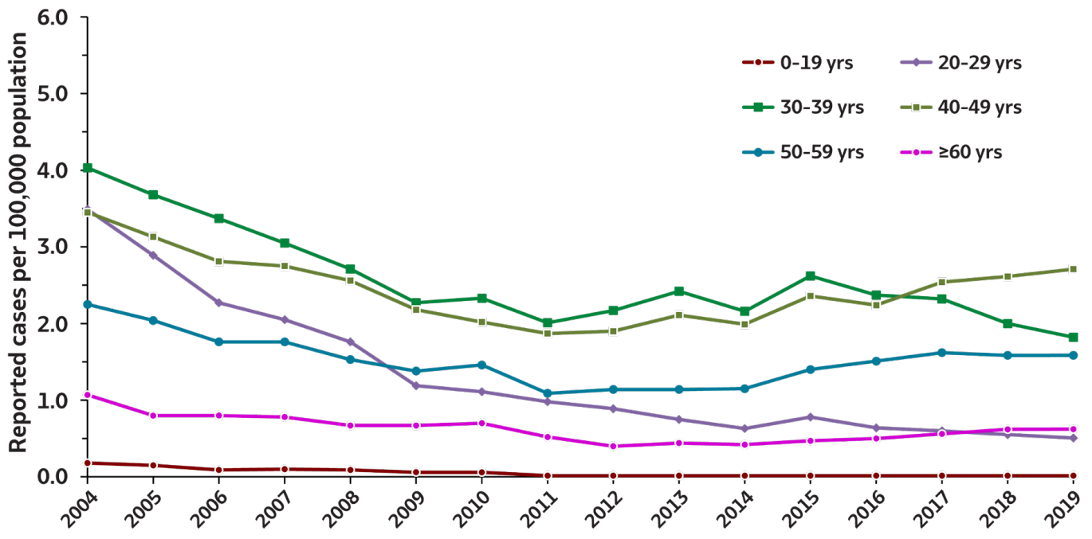
New hepatitis B virus infections are in adults 19 years and up.
https://www.cdc.gov/hepatitis/statistics/2019surveillance/pdfs/2019HepSurveillanceRpt.pdf

Slide 8
Hepatitis B vaccination coverage in adults with ≥1 risk factor decreases by age.
Percentage
Age (years)
Lu et al. National Health Interview Survey, 2018. Unpublished 2021.

Slide 9
Limitations of current risk-based testing approach
Over 2/3 of reported acute cases were either missing risk data or reported no identified risk
Risk identified
30%
Risk data missing
41%
No risk identified
29%
https://www.cdc.gov/hepatitis/statistics/2020surveillance/index.htm

Slide 10

Compared with current practice, universal screening of adults aged 18-79 years would avert
NEEMA, Unpublished Sensitivity Analysis; Toy 2021

Slide 11
Compared with current practice, universal screening of adults aged 18-79 years would avert
7 cases of compensated cirrhosis*
3 cases of decompensated cirrhosis*
5 cases of hepatocellular carcinoma*
2 liver transplants*
10 hepatitis B related deaths*
at a savings of $200,334 per 100,000 adults screened.
*per 100,000 adults screened
NEEMA, Unpublished Sensitivity Analysis; Toy 2021

Slide 12
Recommendation language

Slide 13

NEW: Screening is recommended for all adults aged >18 years at least once in a lifetime

Slide 14

UNCHANGED: Screening is recommended for all pregnant persons during each pregnancy, preferably in the first trimester, regardless of vaccination status or history of testing

Slide 15

Screening Tests
HBsAg
Anti-HBs
Total anti-HBc

Slide 18
Testing recommendations
History of risk for HBV infection (all ages)
  susceptible during the period of risk
Periodic testing for susceptible persons (all ages)
  ongoing risk, while risk persists

Slide 19

NEW: Anyone who requests hepatitis B testing should receive it, regardless of disclosure of risk.

Slide 20
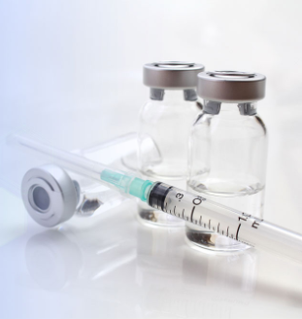
The following groups should receive hepatitis B vaccines:
  Adults aged 19 - 59 years
  Adults aged > 60 years with risk factors for hepatitis B
The following groups may receive hepatitis B vaccines:
  Adults aged > 60 years without known risk factors for hepatitis B
2022 ACIP Recommendations
Adult HepB Vaccination

Slide 21


Collect blood
Offer vaccine per ACIP
No need to wait for results
Screening should not be a barrier to vaccination

Slide 22
Incorporating hepatitis B screening into a clinic workflow
Incorporating hepatitis B screening into a clinic workflow
Nonpregnant adults >18 years without a known history of HBV infection
No/Unknown
Offer screening and vaccine
Previously screened for HBV infection?
Had an activity, exposure, or condition associated with increased risk since the last screening?
No
Offer vaccine
Completed HepB vaccine series?
No/Unk
Yes
Offer testing and vaccine
Yes
No/Unknown
Offer screening
Previously screened for HBV infection?
Had an activity, exposure, or condition associated with increased risk since the last screening?
Yes
No
No action
Yes
Offer testing if the exposure occurred before vaccination (while susceptible) and after the previous HBV test(s)
Yes
Conners et al, 2023 MMWR

Slide 23
The following people have an increased risk for HBV infection and are recommended for periodic testing:
infants born to hepatitis B surface antigen (HBsAg)-positive pregnant people
people born in regions with hepatitis B prevalence >2%
U.S.-born people not vaccinated as infants whose parents were born in regions with hepatitis B prevalence >8%
people with current or past IDU
people currently or formerly incarcerated in a jail, prison, or other detention setting [New recommendation]
people with HIV infection
people with current or past hepatitis C virus infection [New recommendation]
men who have sex with men
people with current or past sexually transmitted infections (STIs) or multiple sex partners [New recommendation]
current or former household contacts of people with known HBV infection
needle-sharing or sexual contacts of people with known HBV infection
persons on maintenance dialysis, including in-center or home hemodialysis and peritoneal dialysis, or who are predialysis
people with elevated alanine aminotransferase (ALT) or aspartate aminotransferase (AST) levels of unknown origin

Slide 24
Hep B testing for nonpregnant adults without history of HBV infection
Incorporating hepatitis B testing into a clinic workflow
Nonpregnant adults >18 years without a known history of HBV infection
No/Unknown
Offer screening and vaccine
Previously screened for HBV infection?
Had an activity, exposure, or condition associated with increased risk since the last screening?
No
Offer vaccine
Completed HepB vaccine series?
No/Unk
Yes
Offer testing and vaccine
Yes
No/Unknown
Offer screening
Previously screened for HBV infection?
Had an activity, exposure, or condition associated with increased risk since the last screening?
Yes
No
No action
Yes
Offer testing if the exposure occurred before vaccination (while susceptible) and after the previous HBV test(s)
Yes
Conners et al, 2023 MMWR

Slide 25
Hep B testing for children and adolescents without known history of Hep B virus infection
Incorporating hepatitis B screening and testing into a clinic workflow
Children and adolescents 1–17 years without a known history of hepatitis B virus infection
Completed hepatitis B vaccine series as an infant?
Has/had an activity, exposure, or condition associated with increased risk?
No
Offer vaccine, if susceptible
No/Unk
Yes
Offer testing if: the exposure occurred while susceptible
Offer vaccine, if susceptible
Yes
No action
Conners et al, 2023 MMWR

Slide 26
Clinical Considerations
Frequency of periodic testing a shared decision
  individual risk factors, immune status

Slide 27
Clinical Considerations
Frequency of periodic testing a shared decision
  individual risk factors, immune status
Multiple sex partners
  insufficient evidence
  number of partners, type of sex, timing of last test

Slide 28
Clinical Considerations
Frequency of periodic testing a shared decision
  individual risk factors, immune status
Multiple sex partners
  insufficient evidence
  number of partners, type of sex, timing of last test
Clinical benefits of screening >80 years of age

Slide 29
Integrating screening and vaccination

Slide 30
Can you draw blood for hepatitis B serology after administering the vaccine?
Blood collection immediately after vaccination is not recommended
HBsAg positivity has been reported for up to 18 days after vaccination
One-time screening with a triple panel should still be offered during future visits, where blood draw is available
Schillie S (2018) MMWR;67(No. RR-1) ;Campioli CC (2021). Mayo Clinic Proceedings: Innovations, Quality & Outcomes; 5(3), 542-547.

Slide 31
What if the provider can’t offer screening at the time of Hep B vaccination?
Screening should not be a barrier to HepB vaccination
One-time screening with a triple panel should still be offered during future visits, where blood draw is available
  cost-effective
Transient HBsAg positivity can occur up to 18 days after vaccination
Schillie S (2018) MMWR;67(No. RR-1) ;Campioli CC (2021). Mayo Clinic Proceedings: Innovations, Quality & Outcomes; 5(3), 542-547.

Slide 32
When should you repeat hepatitis B testing after vaccination?
Serologic testing for immunity is not routinely recommended after vaccination of infants, children, or adults except in specific populations.
Postvaccination serologic testing 1-2 months after vaccination recommended for the following people whose subsequent clinical management depends on knowledge of their immune status:
  infants born to HBsAg-positive person and infants born to gestational parent whose HBsAg status remains unknown (e.g., infants safely surrendered shortly after birth)
  healthcare providers and public safety workers at risk for blood or body fluid exposure
  hemodialysis patients (and other persons who might require outpatient hemodialysis),
  people with an HIV infection
  sex partners of HBsAg-positive persons, to determine the need for revaccination and for other methods of protection against HBV infection.
  other immunocompromised persons (e.g., hematopoietic stem-cell transplant recipients or persons receiving chemotherapy), to determine the need for revaccination and the type of follow-up testing
Schillie 2018, Prevention of Hepatitis B Virus Infection in the United States: Recommendations of the Advisory Committee on Immunization Practices. MMWR.

Slide 33
Hypothetical Clinical Scenarios

Slide 34

Visit 1
Jamal, 45
No HBV risk factors
A year ago received 1st hepB dose (of a 3-dose series)
Wants another dose
No evidence of prior screening

Slide 35
Visit 1
Jamal, 45
No HBV risk factors
A year ago received 1st hepB dose (of a 3-dose series)
Wants another dose
No evidence of prior screening
No/Unknown
Offer screening and vaccine
Previously screened for HBV infection?
Had an activity, exposure, or condition associated with increased risk since the last screening?
No
Offer vaccine
Completed hepatitis B vaccine series?
No/Unk
Yes
Offer testing and vaccine
Yes
No/Unknown
Offer screening
Previously screened for HBV infection?
Had an activity, exposure, or condition associated with increased risk since the last screening?
Yes
No
No action
Yes
Offer testing if the exposure occurred before vaccination (while susceptible) and after the previous HBV test(s)
Yes

Slide 36
Visit 1
Jamal, 45
No HBV risk factors
A year ago received 1st hepB dose (of a 3-dose series
Wants another dose
No evidence of prior screening
Draw blood for triple panel prior to vaccination
When feasible, use vaccine from the same manufacturer to complete the series
  Vaccination should not be deferred when the manufacturer is unknown
  See Schillie S et al. Recommendations of the Advisory Committee on Immunization Practices for Use of a Hepatitis B Vaccine with a Novel Adjuvant. MMWR Morb Mortal Wkly Rep 2018
  2 dose series only considered complete when both doses consist of HepB-CpG

Slide 37
Visit 1: summary
Jamal, 45
No HBV risk factors
A year ago received 1st hepB dose (of a 3-dose series
Wants another dose
No evidence of prior screening
Results:
  HBsAg negative
  Anti-HBc negative
  Anti-HBs positive
Interpretation: No infection, currently immune, but durability is unknown in the absence of a complete series.
Have Jamal return for a 3rd dose in 2 months

Slide 38
Implementation Next Steps
Education
  Providers
  Patients
So, 2023, JAMA Viewpoint; Hepatitis B Foundation Eliminating Hepatitis B Virus Through Universal Screening and Vaccination for Adults Ages 19-59, 2023

Slide 39
Implementation Next Steps
Education
  Providers
  Patients
Setting-specific implementation guides
  Electronic health record alerts
  Integrating screening and vaccination
So, 2023, JAMA Viewpoint; Hepatitis B Foundation Eliminating Hepatitis B Virus Through Universal Screening and Vaccination for Adults Ages 19-59, 2023

Slide 40
Implementation Next Steps
Education
  Providers
  Patients
Setting-specific implementation guides
  Electronic health record alerts
  Integrating screening and vaccination
Chronic hepatitis B panels (HBsAg, anti-HBs, total anti-HBc)
  With summary interpretation
So, 2023, JAMA Viewpoint; Hepatitis B Foundation Eliminating Hepatitis B Virus Through Universal Screening and Vaccination for Adults Ages 19-59, 2023

Slide 41
Implementation Next Step
Education
  Providers
  Patients
Setting-specific implementation guides
  Electronic health record alerts
  Integrating screening and vaccination
Chronic hepatitis B panels (HBsAg, anti-HBs, total anti-HBc)
  With summary interpretation
Streamlining reimbursement for screening
So, 2023, JAMA Viewpoint; Hepatitis B Foundation Eliminating Hepatitis B Virus Through Universal Screening and Vaccination for Adults Ages 19-59, 2023

Slide 42
Implementation Next Steps
Education
  Providers
  Patients
Setting-specific implementation guides
  Electronic health record alerts
  Integrating screening and vaccination
Chronic hepatitis B panels (HBsAg, anti-HBs, total anti-HBc)
  With summary interpretation
Streamlining reimbursement for screening
Possible US Preventive Services Taskforce alignment
So, 2023, JAMA Viewpoint; Hepatitis B Foundation Eliminating Hepatitis B Virus Through Universal Screening and Vaccination for Adults Ages 19-59, 2023

Slide 43
Other Resources
Hepatitis B Online – University of Washington
  https://www.hepatitisb.uw.edu/
  Hepatitis B Management: Guidance for the Primary Care Provider
Hepatitis B Foundation
  https://www.hepb.org/
Web MD
  https://www.medscape.org/viewarticle/972018?src=acdmpart_cdc_972018
Immunize.org
  https://www.immunize.org/askexperts/experts_hepb.asp

Slide 44
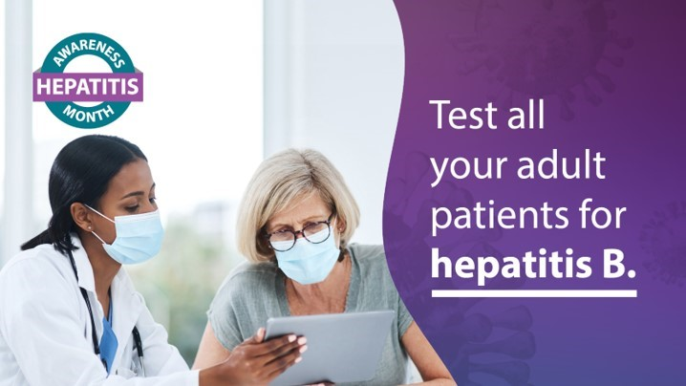
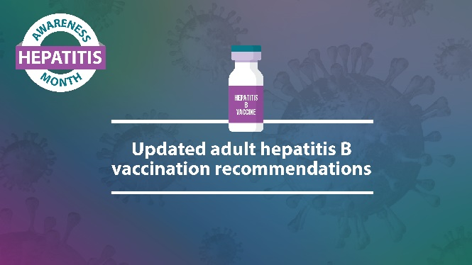
Help spread the word:
Website
  Social media toolkit
  Educational materials
Social Media
  @CDChep; @DrMerminCDC; and CDC enterprise feeds on FB, TW and LinkedIn
  #HepatitisAwarenessMonth
  #HepAware2023
www.cdc.gov/hepatitis/awareness

Slide 45
Questions?
All adults should know their HBV status and be protected from infection

Slide 46
Acknowledgements
Guideline workgroup and steering committee
  Noele Nelson
  Lakshmi Panagiotakopoulos
  Jessica Brown
  Liesl Hagan
  Aaron Harris
  Megan Hofmeister
  Karina Rapposelli
  Amy Sandul
  Philip Spradling
  Carolyn Wester
Prevention Policy Modeling Lab
  Mehlika Toy
  David Hutton
  Joshua Salomon
  Samuel So
HepB Vaccine Guidance
  Mark Weng

