Slide 1
Optimizing Influenza Vaccination for Health Care Personnel to Protect Residents in Post-Acute and
Long-Term Care Facilities
{Insert Speaker Name}
{Insert Speaker Organization}
{Insert Event Name}
{Insert Event Date}

Slide 2

Overview
Background on seasonal flu and flu vaccine
  Flu in post-acute and long-term care facilities (LTCFs)
Low flu vaccination coverage of health care personnel (HCP) in post-acute and LTCFs
Strategies for improving HCP influenza vaccination coverage in post-acute and LTCFs
  Vaccination requirement policies
Resources available to assist with implementing vaccination requirement policies
https://www.cdc.gov/
Notes:
As leaders and administrators in post-acute and long-term care settings, it is likely that you have flu outbreaks in your facilities or have heard about flu circulating among residents in other facilities. We will be discussing flu in these settings and the issues related to low influenza vaccination coverage of health care personnel in these settings. We will be providing strategies to improve flu vaccination coverage of your staff, as well as providing links to resources that are available to help improve flu vaccination coverage of your staff.

Slide 3
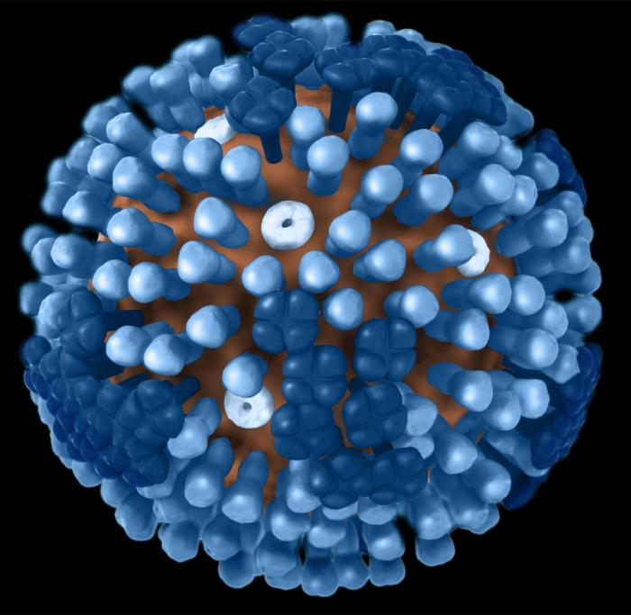
Seasonal Influenza
Influenza is a contagious respiratory illness caused by influenza viruses
Can lead to complications (pneumonia, worsening of chronic medical conditions, such as CHF, asthma, or diabetes) and death
Healthy adults may be able to infect others beginning 1 day before symptoms develop and up to 5 to 7 days after becoming sick
  Best prevention is influenza vaccination
Influenza among HCP is common, and 28% ꟷ 59% of cases estimated are subclinical
  Poses a cross-infection risk to patients
3D graphical representation of a generic Influenza virion
https://phil.cdc.gov/Details.aspx?pid=11874
1. https://www.cdc.gov/flu/keyfacts.htm
2. Wilde JA, McMillan JA, Serwint J, Butta J, O'Riordan MA, Steinhoff MC. Effectiveness of influenza vaccine in health care professionals: a randomized trial. JAMA 1999;281:908--13.
Notes:
Influenza is a contagious respiratory illness caused by influenza viruses
It can lead to complications (pneumonia, worsening of chronic medical conditions, such as CHF, asthma, or diabetes) and death
Healthy adults may be able to infect others beginning 1 day before symptoms develop and up to 5 to 7 days after becoming sick
Best prevention is influenza vaccination
5- 20% of population affected each year
Influenza among HCP is common, and 28% ꟷ 59% of cases estimated are subclinical
This poses a cross-infection risk to patients or residents of LTCFs

Slide 4
Impact of Seasonal Influenza in Adults ≥65 Years
54 – 70% of seasonal flu-related hospitalizations have occurred in people ≥65 years
Risk is greatest in the oldest age group (≥85 years)
  16 times more likely than persons 65 – 84 years
70 – 85% of seasonal flu-related deaths have occurred in people ≥65 years
Case fatality rates in long-term care facilities (LTCF) from influenza complications as high as 55%
https://www.cdc.gov/flu/about/disease/65over.htm
https://www.cdc.gov/mmwr/preview/mmwrhtml/rr59e0729a1.htm
3. Nace DA, Drinka P, Mann J, Poland GA. LTC Information Series: Immunization in the Long-Term Care Setting. 2nd ed. Columbia, MD: American Medical Directors Association; 2010.
4. Morens DM, Rash VM. Lessons from a nursing home outbreak of influenza A. Infect control Hosp Epidemiol. 1995; 16(5):275-80.
Notes:
Influenza is especially severe in older adults.
54 – 70% of seasonal flu-related hospitalizations have occurred in people ≥65 years
The risk is greatest in the oldest age group (≥85 years)
16 times more likely than persons 65 – 84 years
70 – 85% of seasonal flu-related deaths have occurred in people ≥65 years
Case fatality rates in long-term care facilities (LTCF) from influenza complications is as high as 55%

Slide 5
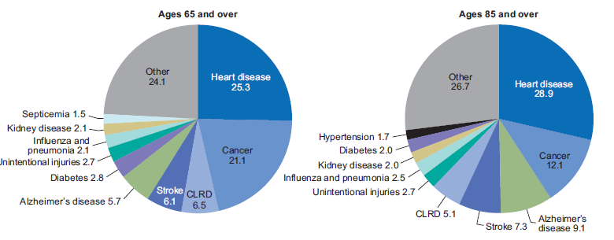
Top Ten Leading Causes of Death in the United States for Adults ≥65 Years and ≥85 Years (2016)
https://www.cdc.gov/nchs/data/nvsr/nvsr67/nvsr67_06.pdf
Notes:
In fact, this figure shows that influenza and pneumonia are among the top 10 leading causes of death in the US for adults 65 and older (in the pie chart on the left) and 85 and older (in the pie chart on the right).

Slide 6
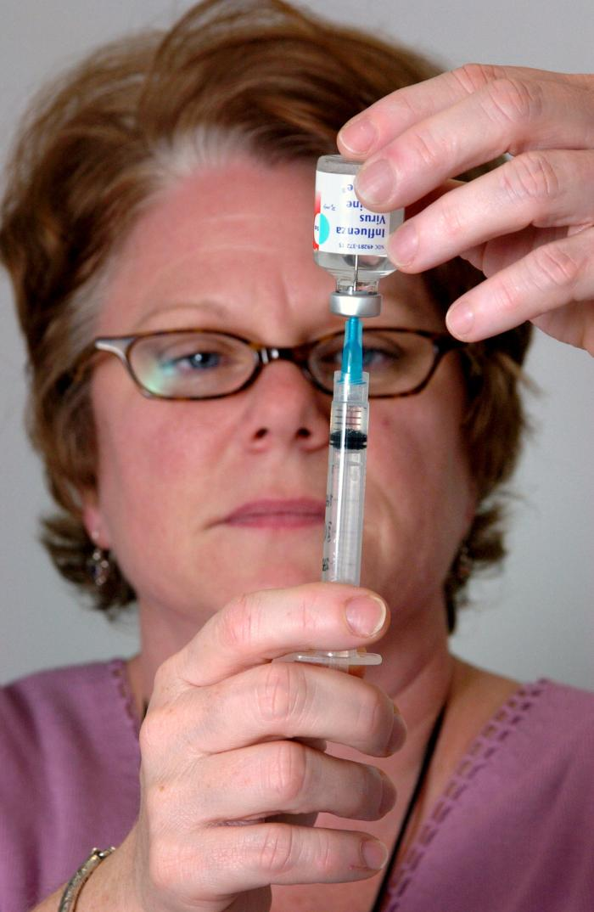
Influenza Vaccination
CDC preliminary adjusted vaccine effectiveness (VE) estimates for the 2017-2018 flu season in U.S.:
  40% vaccine VE overall
  20% VE among adults ≥65 years
  During the 2016-2017 influenza season, flu vaccine prevented (VE was 40% overall):
    5.3 million influenza illnesses
    2.6 million medical visits
    85,000 influenza-associated hospitalizations
  Increasing vaccination coverage among persons aged 18- 64 yrs could greatly reduce adult illness and work absenteeism
https://phil.cdc.gov/Details.aspx?pid=5401
2017- 2018 Flu VE estimates presented at ACIP on June 20: https://www.cdc.gov/vaccines/acip/meetings/live-mtg-2018-06.html
https://www.cdc.gov/flu/about/season/flu-season-2017-2018.htm
Notes:
Nonetheless, the way to mitigate this risk is seasonal influenza vaccination. Although the vaccine generally has modest effectiveness (it was 40% effective overall last season and only 20% effective overall among adults 65 and older), it still makes a huge impact.
During the 2016-2017 influenza season when vaccine effectiveness was also 40% overall, flu vaccine prevented:
5.3 million influenza illnesses
2.6 million medical visits
85,000 influenza-associated hospitalizations
Additionally, increasing vaccination coverage among persons aged 18- 64 yrs could greatly reduce adult illness and work absenteeism

Slide 7
Benefits of Influenza Vaccination
Influenza vaccination has resulted in reduction in death and ICU admissions, and shortened ICU and hospital stays in adults hospitalized with laboratory-confirmed influenza (2013- 14 season)
  Greatest benefit was among adults ≥65 yrs
From 2012ꟷ 2015, flu vaccination among adults reduced the risk of an ICU admission with influenza by 82%
Vaccination has been associated with lower rates of some cardiac events among people with heart disease
Flu vaccination associated with reduced hospitalizations among people with diabetes and chronic lung disease
1. Arriola C, Garg S, Anderson EJ, et al. Influenza Vaccination Modifies Disease Severity Among Community-dwelling Adults Hospitalized With Influenza. Clin Infect Dis. 2017 Oct 15;65(8):1289-1297.
2. Thompson MG, Pierse N, Huang S, et al. Influenza vaccine effectiveness in preventing influenza-associated intensive care admissions and attenuating severe disease among adults in New Zealand 2012–2015. Vaccine. 2018; 36 (39): 5916-25.
3. Udell JA, Zawi R, Bhatt DL, et al. Association between influenza vaccination and cardiovascular outcomes in high-risk patients: a meta-analysis. JAMA. 2013;310(16): 1711-20.
4. https://www.cdc.gov/flu/protect/keyfacts.htm
Notes:
There are other notable, published benefits of influenza vaccination.
Influenza vaccination has resulted in reduction in death and ICU admissions, and shortened ICU and hospital stays in adults hospitalized with laboratory-confirmed influenza (2013- 14 season)
Greatest benefit was among adults ≥65 yrs
From 2012ꟷ 2015, flu vaccination among adults reduced the risk of an ICU admission with influenza by 82%
Vaccination has been associated with lower rates of some cardiac events among people with heart disease
Flu vaccination associated with reduced hospitalizations among people with diabetes and chronic lung disease

Slide 8

Influenza Outbreaks in Post-Acute and
Long-Term Care Facilities (LTCFs)
Influenza outbreaks in post-acute and LTCFs are common
  In 2017-2018, from select states:
    Minnesota had 184 confirmed influenza outbreaks in LTCFs
    Kentucky had 124 confirmed influenza outbreaks in LTCFS
Factors contributing to outbreaks in these settings:
  Close living proximity
  Immune senescence in older adults
  Comorbidities
  Reduced immune response to vaccine
Sign from Ottawa Health
http://www.health.state.mn.us/divs/idepc/diseases/flu/stats/flustats10.pdf
https://healthalerts.ky.gov/Documents/fluactivity.pdf
Notes:
Despite the availability of a vaccine, influenza is very common, and outbreaks in long-term care facilities are common.
In 2017-2018, from select states:
Minnesota had 184 confirmed influenza outbreaks in LTCFs
Kentucky had 124 confirmed influenza outbreaks in LTCFS
Factors contributing to outbreaks in these settings:
Close living proximity
Immune senescence in older adults
Comorbidities
Reduced immune response to vaccine

Slide 9
Influenza Outbreaks in LTCFs Associated with Low Vaccination Rates among Health Care Personnel
Influenza outbreaks in LTCFs have been associated with low vaccination rates among health care personnel (HCP)
Randomized controlled studies on the impact of HCP vaccination on resident morbidity and mortality in LTCFs have demonstrated substantial decreases in:
  All-cause mortality
  Influenza-like illness
Saito R, Suzuki H, Oshitani H, et al. The effectiveness of influenza vaccine against influenza a (H3N2) virus infections in nursing homes in Niigata, Japan, during the 1998--1999 and 1999--2000 seasons. Infect Control Hosp Epidemiol 2002;23:82--6.
Lemaitre M, Meret T, Rothan-Tondeur M, et al. Effect of influenza vaccination of nursing home staff on mortality of residents: a cluster-randomized trial. J Am Geriatr Soc 2009;57:1580--6.
Carman WF, Elder AG, Wallace LA, et al. Effects of influenza vaccination of health-care workers on mortality of elderly people in long-term care: a randomised controlled trial. Lancet 2000;355:93--7.
Hayward AC, Harling R, Wetten S, et al. Effectiveness of an influenza vaccine programme for care home staff to prevent death, morbidity, and health service use among residents: cluster randomised controlled trial. BMJ 2006;333:1241.
Potter J, Stott DJ, Roberts MA, et al. Influenza vaccination of health care workers in long-term-care hospitals reduces the mortality of elderly patients. J Infect Dis 1997;175:1--6.
Notes:
Studies have shown that influenza outbreaks in LTCFs have been associated with low vaccination rates among health care personnel (HCP)
Additionally, randomized controlled studies on the impact of HCP vaccination on resident morbidity and mortality in LTCFs have demonstrated substantial decreases in:
All-cause mortality
Influenza-like illness

Slide 10
Why Focus on Vaccinating Health Care Personnel against Influenza in Post-Acute and LTCFs?
CDC recommends that HCP should be vaccinated annually against influenza
  This recommendation includes a continued emphasis on vaccinating HCP who work in LTCFs, because their patient population is at high risk for serious complications from influenza, and due to the risk of influenza outbreaks in these facilities
1. Grohskopf LA, Sokolow LZ, Broder KR, et al. Prevention and control of seasonal influenza with vaccines: Recommendations of the Advisory Committee on Immunization Practices—United States, 2017-18 Influenza Season. MMWR Recomm Rep. 2017;66(2):1-20.
Notes:
The question of today is why should we focus on vaccinating health care personnel against influenza in LTCFs?
A main reason is that CDC recommends that HCP should be vaccinated annually against influenza.
This recommendation includes a continued emphasis on vaccinating HCP who work in LTCFs, because their patient population is at high risk for serious complications from influenza, and due to the risk of influenza outbreaks in these facilities.

Slide 11
Why Focus on Health Care Personnel in Post-Acute and LTCFs? (Continued)
Protects residents who are high-risk due to age and co-morbid conditions
  HCP can serve as vectors
  HCP have high contact with residents
Improves quality of care by decreasing HCP absenteeism
  Absenteeism in LTCFs is associated with reduced quality of care (measured by physical restraint use, catheter use, pain management, and pressure sores)
Benefits employees (personal protection of HCP and their families)
Professional societies support it (e.g., AMDA)
Hayward AC, Harling R, Wetten S, et al. Effectiveness of an influenza vaccine programme for care home staff to prevent death, morbidity, and health service use among residents: cluster randomised controlled trial. BMJ 2006;333:1241.
Notes:
Additional reasons are because vaccination of health care personnel:
Protects residents who are high-risk due to age and co-morbid conditions
- HCP can serve as vectors
HCP have high contact with residents
Vaccination improves quality of care by decreasing HCP absenteeism
Absenteeism in LTCFs is associated with reduced quality of care (measured by physical restraint use, catheter use, pain management, and pressure sores)
Vaccination benefits employees (personal protection of HCP and their families)
Additionally, professional societies support it (e.g., AMDA)

Slide 12
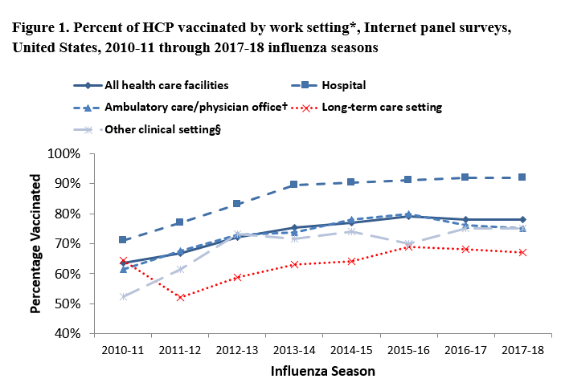
Influenza Vaccination Coverage of HCP by Facility Type
Black CL, Yue X, Ball SW, et al. Influenza Vaccination Coverage Among Health Care Personnel — United States, 2017–18 Influenza Season. MMWR. 2018; 67(38):1050-4. DOI: http://dx.doi.org/10.15585/mmwr.mm6738a2
12
Notes:
Nonetheless, during the 2017–18 influenza season, influenza vaccination coverage was lowest among HCP working in long-term care settings (67%) (in red), compared with HCP working in hospitals (92%).
Healthy People 2020 annual target goal for influenza vaccination among HCP is 90%
Since at least the 2011–12 influenza season, HCP in long-term care settings have had the lowest reported influenza vaccination rates among all HCP.

Slide 13
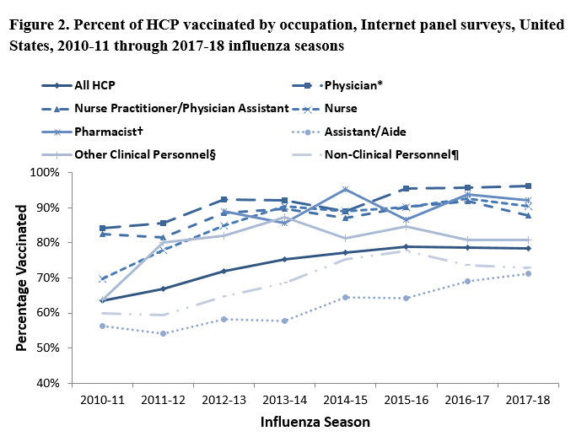
Influenza Vaccination Coverage by HCP Occupation
Black CL, Yue X, Ball SW, et al. Influenza Vaccination Coverage Among Health Care Personnel — United States, 2017–18 Influenza Season. MMWR. 2018; 67(38):1050-4. DOI: http://dx.doi.org/10.15585/mmwr.mm6738a2
Notes:
This figure shows the breakdown by occupation and reflects data collected from a CDC internet panel survey. Nursing assistants/aides had the lowest vaccination rates each season. Considering that nursing assistants/aides are providing the majority of hands-on care and have frequent contact with residents in LTCFs, this highlights a major concern.

Slide 14
Misconceptions about Influenza Vaccination from HCP
Studies show that a large percentage of HCP in LTCFs hold inaccurate beliefs about the influenza vaccine: ~40% HCP disagreed with the following statement: “Vaccine does not cause influenza.”
  Vaccination rates are almost 30 percentage points higher among HCP who believe that the vaccine is effective
  Vaccination rates are 12 percentage points higher among HCP who believe that the vaccine does not cause influenza
When asked why they do not receive the vaccine, HCP typically cite:
  A fear of needles
  Worries of side effects
  Concerns about contracting the virus from the vaccine
  A belief that they are not at risk of contracting influenza
  A desire to avoid medications
  Daugherty JD, Blake SC, Grosholz JM, et al. Influenza vaccination rates and beliefs about vaccination among nursing home employees. Amer J Infect Control 2015; 43 (2): 100-6
Notes:
This underscores the fact that despite all of the available resources on influenza vaccination there are still many misconceptions about the vaccine, even among HCP.
Studies show that a large percentage of HCP in LTCFs hold inaccurate beliefs about the influenza vaccine: ~40% HCP disagreed with the following statement: “Vaccine does not cause influenza.”
Vaccination rates are almost 30 percentage points higher among HCP who believe that the vaccine is effective
Vaccination rates are 12 percentage points higher among HCP who believe that the vaccine does not cause influenza
When asked why they do not receive the vaccine, HCP typically cite:
A fear of needles
Worries of side effects
Concerns about contracting the virus from the vaccine
A belief that they are not at risk of contracting influenza
A desire to avoid medications

Slide 15
Strategies for Improving
HCP Vaccination Rates in Post-Acute and LTCFs
Vaccination rates among HCPs at LTCFs increase and HCP absenteeism decrease after:
  Multifaceted interventions that engage stakeholders
  Focus on creating an environment that supports risk reduction
Education programs have a limited impact on vaccination rates
  However, compared with nurses who did not receive educational interventions, nurses exposed to the interventions were:
    More likely to encourage others to be vaccinated, and
    More likely to discuss vaccination with residents
Ofstead C, Amelang M, Wetzler H, Tan L. Moving the needle on nursing staff influenza vaccination in long-term care: Results of an evidence-based intervention. Vaccine. 2017;
Notes:
However, there are strategies for improving HCP vaccination rates in LTCFs.
Vaccination rates among HCPs at LTCFs increase and HCP absenteeism decrease after:
Multifaceted interventions that engage stakeholders
Focus on creating an environment that supports risk reduction
And although education programs generally have a limited impact on vaccination rates, compared with nurses who did not receive educational interventions, nurses exposed to the interventions were:
More likely to encourage others to be vaccinated, and
More likely to discuss vaccination with residents

Slide 16
Other Strategies for Success
Cede Vaccination Policy to Pharmacy Control
  Place the responsibility of administering and tracking vaccinations out of the hands of HCP located in LTCFs who might have high turn-over rates and competing demands
Standing Orders
Eliminate Consent Forms
Require Declinations
Although rates at LTCF sites improved influenza vaccination coverage of HCP with voluntary measures, it remains a challenge to meet the Healthy People 2020 goals and might require mandatory programs to reach 90% or higher levels
1. Nace DA, Handler SM, Hoffman EL, et al. Impact of the raising immunizations safely and effectively (RISE) program on healthcare worker influenza immunization rates in long-term care settings. J Am Med Dir Assoc. 2012;13(9): 806-10.
2. https://innovations.ahrq.gov/taxonomy-terms/influenza-virus-vaccine
Notes:
Other strategies that have successfully increased vaccination rates in LTCFs have included:
Ceding Vaccination Policy to Pharmacy Control
This has involved placing the responsibility of administering and tracking vaccinations out of the hands of HCP located in LTCFs who might have high turn-over rates and competing demands. This was a study done by Dr Nace (in the audience).
Other strategies have included:
Standing Orders
Eliminate Consent Forms
Require Declinations
However, although rates at LTCF sites improved influenza vaccination coverage of HCP with voluntary measures, it remains a challenge to meet the Healthy People 2020 goals and might require mandatory programs to reach 90% or higher levels

Slide 17

AMDA’s 2018 Updated Policy
AMDA - The Society for Post-Acute and Long-Term Care Medicine (the Society) supports mandatory annual influenza vaccination for all post-acute and long-term care HCP unless there is a medical contraindication
All HCP should be included in mandatory influenza vaccination programs, as all HCP, even those with indirect contact, have the potential to be in close proximity with residents, which can allow for transmission of infection
https://paltc.org/sites/default/files/AMDA%20Flu%20Vaccine%20Policy%20Final2.pdf
Notes:
AMDA, the professional society dedicated to Long Term Care Medicine, supports a mandatory annual influenza vaccination for every long-term health care worker who has direct patient contact unless a medical contraindication or religious objection exists. They state that: All HCP should be included in mandatory influenza vaccination programs, as all HCP, even those with indirect contact, have the potential to be in close proximity with residents, which can allow for transmission of infection.

Slide 18
Other Professional Societies’ that Support Influenza Vaccination Requirements of HCP
-- American Academy of Family Physicians (AAFP)
-- American Academy of PAs (AAPA)
-- American College of Physicians (ACP)
-- American Hospital Association (AHA)
-- American Nurses Association (ANA)
-- American Pharmacists Association (APhA)
-- American Public Health Association (APHA)
-- Infectious Diseases Society of America (IDSA)
-- National Foundation for Infectious Diseases (NFID)
-- National Patient Safety Foundation (NPSF)
-- Society for Healthcare Epidemiology of America (SHEA)
-- Association for Professionals in Infection Control and Epidemiology (APIC)
Notes:
Other professional societies have taken a similar stance, as shown here.

Slide 19
Why Focus on Influenza Vaccination Requirements?
Voluntary measures have generally NOT been successful in raising HCP influenza vaccination coverage to the Healthy People 2020 goal of ≥90% coverage
In a national survey, the percentage of HCP in LTCFs who were vaccinated (by employer approach to influenza vaccination):
  Work requirement (89%)
  Promoted by employer (vaccine offered on-site >1 day at no cost to HCP), but not required (59%)
  No employer requirement or vaccine promotion (42%)
1. Hollmeyer H, Hayden F, Mounts A, Buchholz U. Review: interventions to increase influenza vaccination among healthcare workers in hospitals. Influenza Other Respir Viruses. 2013;7(4):604-621.
2. Black CL, Yue X, Ball SW, et al. Influenza Vaccination Coverage Among Health Care Personnel — United States, 2017–18 Influenza Season. MMWR. 2018; 67(38):1050-4. DOI: http://dx.doi.org/10.15585/mmwr.mm6738a2
Notes:
Voluntary measures have generally NOT been successful in raising HCP influenza vaccination coverage to the Healthy People 2020 goal of ≥90% coverage, as I previously mentioned.
In a national survey, the percentage of HCP in LTCFs who were vaccinated (by employer approach to influenza vaccination):
89% of HCP in LTCFs where there was a work requirement
59% of HCP in LTCFs where vaccination was Promoted by the employer (vaccine offered on-site >1 day at no cost to HCP), but not required
And only 42% when there was no employer requirement or vaccine promotion

Slide 20
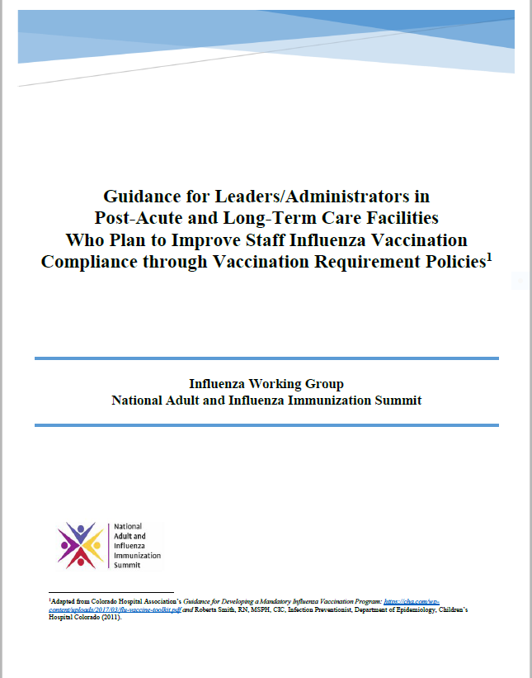
NAIIS Guidance Document for Developing a Vaccination Requirement for HCP in Post- Acute and LTCFs
Purpose of document:
To provide guidance and information for developing an influenza vaccination requirement policy HCP in post-acute and LTCFs
Provides a framework for major areas that should be considered when adopting an influenza vaccination requirement policy
www.izsummitpartners.org/guidance-for-developing-a-flu-vax-reqt-policy-for-hcp-in-post-acute-and-ltcf
20
Notes:
As a result of the data we just shared, and with the support of professional organizations almost across the board, our WG decided last year to develop guidance for any post-acute or LTCF that was interested in implementing requirements for HCP to receive influenza vaccination.
This document provides a framework for major areas that should be considered when adopting an influenza vaccination requirement policy.

Slide 21
NAIIS Guidance Document for Implementing Influenza Vaccination Requirement for HCP
Includes sections (in modular format) on:
Rationale and supporting evidence for HCP vaccination
Implementing a vaccination requirement policy
Employee engagement
Ethical considerations
Resources
FAQs
Sample Policy
Sample Exemption Form
www.izsummitpartners.org/guidance-for-developing-a-flu-vax-reqt-policy-for-hcp-in-post-acute-and-ltcf
Notes:
The document includes sections on:
Rationale and supporting evidence for HCP vaccination
Implementing a vaccination requirement policy
Employee engagement
Ethical considerations
Resources
FAQs
Sample Policy
Sample Exemption Form

Slide 22
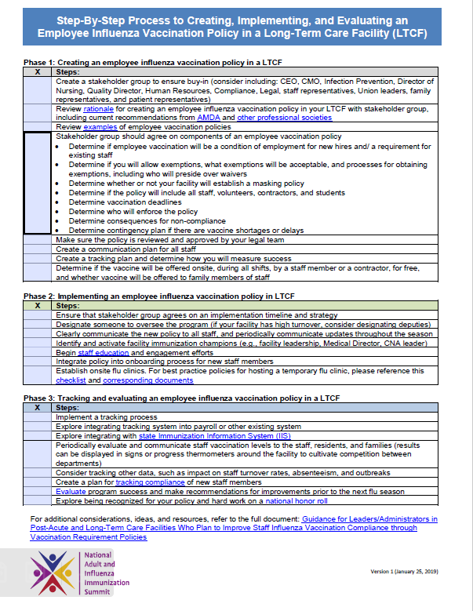
1-Page Checklist for Implementing an Employee Influenza Vaccination Policy
www.izsummitpartners.org/step-by-step-for-flu-vax-reqt-for-hcp-in-post-acute-and-ltcf

Slide 23
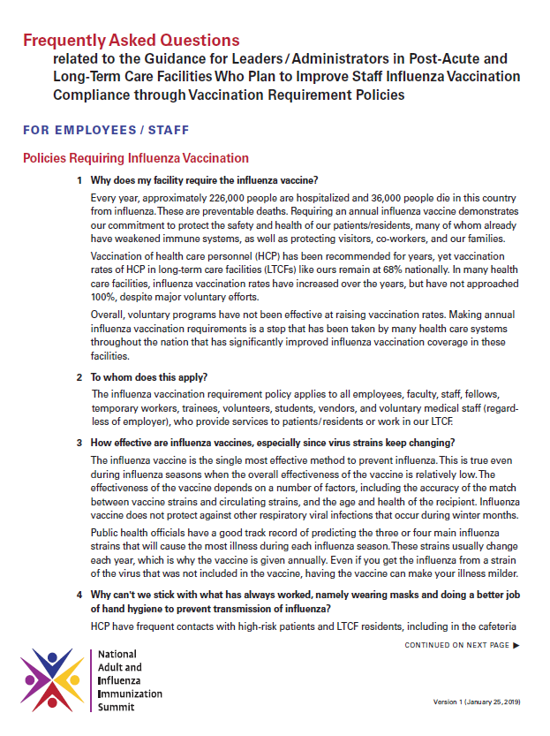
FAQs for Implementing Employee Influenza Vaccination Policies
www.izsummitpartners.org/faqs-for-implementing-flu-vax-policy-in-post-acute-and-ltcf

Slide 24
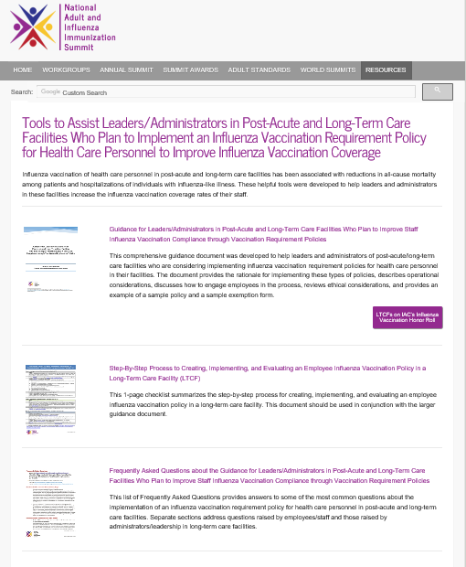
Landing Page for All of These Resources
https://www.izsummitpartners.org/naiis-workgroups/influenza-workgroup/tools-for-ltcf/

Slide 25
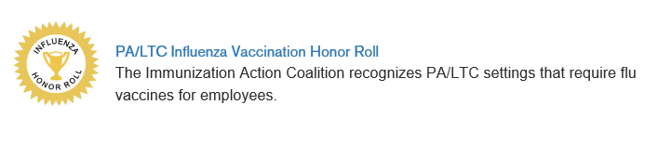
Immunization Action Coalition and AMDA
Influenza Vaccination Honor Roll
The Immunization Action Coalition and AMDA recognize facilities that have influenza vaccination mandates for HCP
To be included in this honor roll, a facility’s mandate must require influenza vaccination for employees and must include serious measures to prevent transmission of influenza from unvaccinated workers to patients/residents (e.g., mask requirement or reassignment to non-patient-care duties)
As of 2/21/2019, only 23 post-acute and LTCF recognized on the honor roll
http://www.immunize.org/honor-roll/influenza-mandates/ltc.asp
Notes:
The Immunization Action Coalition and AMDA recognize facilities that have influenza vaccination mandates for HCP
To be included in this honor roll, a facility’s mandate must require influenza vaccination for employees and must include serious measures to prevent transmission of influenza from unvaccinated workers to patients/residents (e.g., mask requirement or reassignment to non-patient-care duties)
Currently only 23 post-acute and LTCF recognized on the honor roll. Granted this might be an underrepresentation, considering some states, such as Minnesota, have their blue ribbon panels of long-term care facilities that have 90% coverage or greater (that might not have submitted to be on the IAC honor roll), but when you consider that there are more than 600 hospitals and acute care facilities on the honor roll, it does make us realize how far we have to go in the long-term care environment.

Slide 26
Influenza Vaccination Clinics in Non-Traditional Settings
Satellite, temporary, and off-site vaccination clinics (including workplace clinics) play an important role in improving vaccination coverage rates
17% of adults in the U.S. receive their influenza vaccination at their workplace
Vaccination clinics held in non-traditional settings may lead to unsafe environments, vaccine temperature excursions, and vaccine administration errors
  Includes vaccination clinics for HCP in hallways, classrooms, cafeterias, etc.
https://www.cdc.gov/flu/fluvaxview/nifs-estimates-nov2017.htm
Notes:
Now that we’ve established why influenza vaccination is important for health care personnel in LTCFs, we want to spend a moment discussing the importance of influenza vaccination clinics held in non-traditional settings, including vaccination clinics held at the workplace which are often done in the hallways, classrooms, or cafeterias. These vaccination clinics play an important role in improving vaccination coverage rates. In fact, 17% of adults in the US receive their influenza vaccination at the workplace.
However, vaccination clinics held in non-traditional settings may lead to unsafe environments, vaccine temperature excursions, and vaccine administration errors.

Slide 27
Checklist of Best Practices, the Pledge, and Accompanying Resources
Checklist of Best Practices for Vaccination Clinics Held at Satellite, Temporary, or Off-site Locations:
Step-by-step guide to help clinic supervisors overseeing vaccination clinics held at satellite, temporary, or off-site locations follow Centers for Disease Control and Prevention (CDC) guidelines and best practices
Standardized each step: vaccine shipment, transport, storage, handling, preparation, administration, and documentation
Pledge for Organizations Implementing Vaccination Clinics Held at Satellite, Temporary, or Off-site Locations:
For organizations that conduct satellite, temporary, or off-site vaccination clinics to sign annually affirming that they will adhere to best practices
Organizations that sign the pledge are recognized on the Summit website
https://www.izsummitpartners.org/naiis-workgroups/influenza-workgroup/off-site-clinic-resources/
27
Notes:
Thus, in an effort to standardize the process of holding clinics in these non-traditional settings, the Summit’s Influenza Working Group made our 1st objective (back when we originally began the WG), the development of:
The Checklist of Best Practices for Vaccination Clinics Held at Satellite, Temporary, or Off-site Locations which is a step-by-step guide to help clinic coordinators/supervisors overseeing vaccination clinics held at satellite, temporary, or off-site locations follow Centers for Disease Control and Prevention (CDC) guidelines and best practices for vaccine shipment, transport, storage, handling, preparation, administration, and documentation. This checklist can (and should) be used when facilities hold flu immunization clinics for their staff or residents that are done in temporary setting. The checklist ensures that all vaccination clinics uphold the same standards so that the vaccine being delivered is not compromised and is administered safely.
The pledge is for organizations that conduct satellite, temporary, or off-site vaccination clinics to sign annually affirming that they will adhere to best practices, including using the Checklist of Best Practices for Vaccination Clinics Held at Satellite, Temporary, or Off-Site Locations. Organizations that sign the pledge will be recognized on the Summit website.
The link to all of these documents is on the bottom of the slide.

Slide 28
Summary
Influenza can lead to severe complications in LTCF residents
Vaccination is the best method of preventing influenza
LTCFs have the lowest vaccination of HCP (of all healthcare facility types)
Voluntary measures, easy access to vaccination, staff engagement can help increase rates
  But generally not enough to reach Healthy People 2020 goal of 90% (and not sustained)
Vaccination requirements for HCP are supported by professional societies and might help achieve 90% coverage
Notes:
We covered a lot of ground, but in summary:
Influenza can lead to severe complications in LTCF residents
Vaccination is the best method of preventing influenza
LTCFs have the lowest vaccination of HCP (of all healthcare facility types)
Voluntary measures, easy access to vaccination, staff engagement can help increase rates
But generally not enough to reach Healthy People 2020 goal of 90% (and not sustained)
Vaccination requirements for HCP are supported by professional societies and might help achieve 90% coverage

