Slide 1
National Influenza Vaccination Week
(NIVW) 2016
Kathleen LaPorte
Seasonal Flu Campaign Digital Lead
National Center for Immunization and Respiratory Diseases
Health Communication Science Office
November 17, 2016

Slide 2
NIVW 2016
This year, NIVW will be December 4-10, 2016
Goals of NIVW:
  Highlight the importance of continuing flu vaccination through the holiday season and beyond
  Communicate the importance of flu vaccination for people who are at high risk of developing serious flu-related complications.
Flu vaccination coverage estimates from past years have shown that influenza vaccination activity drops quickly after the end of November
NIVW occurs in December to remind people that even though the holiday season has arrived, it is not too late to get your flu vaccine
For more information about NIVW, visit: www.cdc.gov/flu/nivw/about.htm

Slide 3
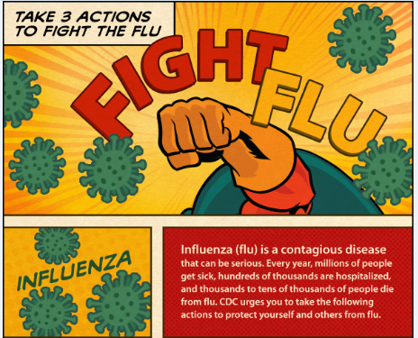
NIVW Messages and Resources
NIVW 2016 Key Messages
Take 3 Actions Flu Listicle
NIVW Communication Material:
  Social Media Messages and graphics
  Posters
  Web Badges
  Animated graphic
All of these resources can be found online at www.cdc.gov/flu/nivw
*content is currently in the process of being updated for the current season
Notes:
- NIVW Key Messages to Include: Newsletter Content, Social Media Content, Dates and Activities, Graphics

Slide 4
NIVW Activities
Blog-a-Thon:
  CDC will be kicking off a blog-a-thon Monday, December 4 with a post on CDC’s Public Health Matters.
  Blog-a-thon will feature blogs throughout the week of NIVW that push the importance of continuing flu vaccination.
  Partners are encouraged to participate and contribute a blog of their own.
    A Blog-a-thon badge will be available to accompany your blog post.
Twitter Hashtag Challenge:
  @CDCFlu Twitter will host a challenge game called #FluInAMovie on Wednesday, December 7 from 11am-1pm EST.
  How you can participate:
      Using the hashtag #FluInAMovie, tweet a popular movie title and replace one of the words in the title with the word “flu,” and share a message that emphasizes the importance of flu vaccination.
      Example Tweet: The Hunger Games: Catching Flu. Don’t catch the #flu this season. A flu vaccine is 1st & best protection against flu. #FluInAMovie
CDC's #FightFlu Social Media Campaign
  The #FightFlu social media campaign captures and shares flu vaccination activities. During or after getting a flu shot, share photos and videos of yourself (tag #FightFlu) on digital platforms.
  CDC will post weekly updates to the campaign timeline: https://www.cdc.gov/flu/partners/timeline/fightflu.htm.
If you have questions or are interested in participating, please email: fluinbox@cdc.gov
Notes:
This year, instead of doing the traditional Twitter Chat, CDC is hosting a Hashtag Challenge.

Slide 5
NIVW Success Stories
CDC would love to hear about your successful NIVW activities and events!
Share your story by submitting the following information to fluinbox@cdc.gov.
  Write a 250 word (maximum) description of your success story including name of organization, any collaborating organizations, when the event took place (either last flu season or this flu season only), and any evaluation taken from the activity.
  Include a minimum of (1-2) pictures of the event. Acceptable file formats include JPG, GIF, and PNG. Preferred size at least 500 by 300 pixels (or larger).
  Include contact information in case CDC follow up is needed. Please let us know if we can share your contact information within your success story in case other organizations would like to partner with you for future events.
Past Success Stories: https://www.cdc.gov/flu/partners/success_stories.htm

Slide 6
Questions?
Email to: fluinbox@cdc.gov or Visit: www.cdc.gov/flu/nivw

